Slide 1
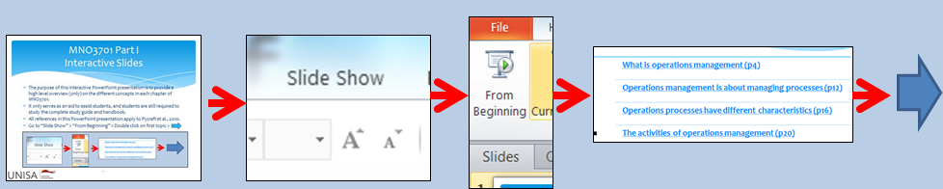

MNO3701 Part II
Interactive Slides
The purpose of this interactive PowerPoint presentation is to provide a high level overview (only) on the different concepts in each chapter of MNO3701.
It only serves as an aid to assist students, and students are still required to study the complete study guide and handbook.
All references in this PowerPoint presentation apply to Pycraft et al., 2010.
Go to “Slide Show” > “From Beginning” > Double click on first topic >

Slide 2
MNO3701 Part II Topic 3
Chapter 4
The design activity (p83)
Process types – the volume –variety effect on process design (p87)
Detailed process design (p95)
The effects of process variability (p102)
Summary (p104)

Slide 3
The design activity
To “design” is to conceive the looks, arrangement and workings of something before it is constructed.
(Pycraft et al., 2010: 83)

Slide 4
Process types – the volume – variety effect on process design
Terms that are used to describe a particular general approach to managing processes: in manufacturing these are generally held to be project, jobbing, batch, mass and continuous processes; in services they are held to be professional services, service shops and mass services.
(Pycraft et al., 2010: 87)

Slide 5
Detailed process design
After the overall design of a process has been determined, its individual activities must be configured.
Because of this, process design is often done using some simple visual approach such as process mapping:
  Describing processes in terms of how the activities within the process relate to each other (may also be called process blueprinting or process analysis).
  (Pycraft et al., 2010: 95)

Slide 6
The effects of process variability
There are many reasons why variability occurs in processes.
Two fundamental types of variability:
  Variability in the demand for processing at an individual stage within the process, usually expressed in terms of variation in the inter-arrival times of units to be processed;
  Variation in the time taken to perform the activities (i.e. process a unit) at each stage.
  (Pycraft et al., 2010: 102)

Slide 7
MNO3701 Part II Topic 3
Chapter 8
What is process technology? (p213)
Materials-processing technology (p215)
Information –processing technology (p217)
Customer-processing technology(p224)
Process technology should reflect volume and variety (p228)
Summary (p234)

Slide 8
What is process technology?
The machines and devices that create and/or deliver goods and services.
(Pycraft et al., 2010: 213)

Slide 9
Materials-processing technology
Computer numerically controlled machine tools (CNC): Machines that use a computer to control their activities, as opposed to those controlled directly through human intervention
Robots: Automatic manipulators of transformed resources whose movement can be programmed and reprogrammed.
Automated guided vehicles (AGVs): Small, independently powered vehicles that move material to and from value-adding operations.
Flexible manufacturing systems (FMS): Manufacturing systems that bring together several technologies into a coherent system, such as metal cutting and material handling technologies, usually their activities are controlled by a single governing computer.
Computer-integrated manufacturing (CIM): A term used to describe the integration of computer-based monitoring and control of all aspects of a manufacturing process, often using a common database and communicating via some form of computer network.
(Pycraft et al., 2010: 215 - 216)

Slide 10
Information processing technology (IT)
Any device, or collection of devices, that collects, manipulates, stores or distributes information, nearly always used to mean computer-based devices.
(Pycraft et al., 2010: 217)

Slide 11
Customer–processing technology
Two types of customer-processing technologies:
  Those you interact with yourself, and
  Those that are operated by an intermediary.
Technology involving customer interaction
  Active interaction technology
  Passive interactive technology
Types of interaction between the customer and technology | Examples
Active interaction with technology | Mobile phone services, Internet-based ordering Email, Cash machines
Passive interaction with technology | Transport systems, Theme park rides, Automatic car wash
Hidden interaction with the technology | Security cameras, Retail scanners, Credit card tracking
Interaction with the technology through an intermediary | Call centre technology, Travel shop’s booking system
(Pycraft et al., 2010: 226)

Slide 12
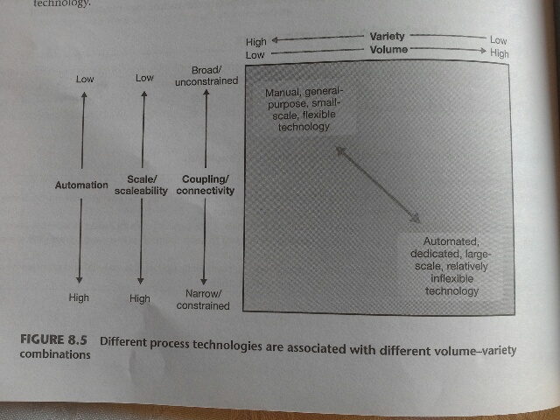
Process technology should reflect volume and variety
(Pycract et al., 2010Picture : 228)

Slide 13
MNO3701 Part II Topic 4
Chapter 10
What is planning and control? (p273)
The nature of supply and demand (p275)
Planning and control activities (p280)
Summary (p295)

Slide 14
What is planning and control?
Planning and control reconciles supply and demand.
Planning concerns what should happen in the future – The formulation of what is intended to happen at some time in the future.
Control copes with changes – The process of monitoring operations activity and coping with any deviations form the plan; usually involves elements of re-planning.
(Pycraft et al., 2010: 273)

Slide 15
The nature of supply and demand
Uncertainty in supply and demand
Dependent and independent demand
  Dependent demand – Demand that is relatively predictable because it is derived from some other known factor.
  Independent demand – Demand that is not obviously or directly dependent on the demand for other product or service.
  (Pycraft et al,. 2010: 275 – 277)

Slide 16
Planning and control activities
Loading – the amount of work that is allocated to a work centre.
Sequencing – The activity within planning and control that decides on the order in which work is to be performed.
Scheduling – A term used in planning and control to indicate the detailed timetable of what work should be done, when it should be done and where it should be done.
Monitoring and controlling the operation:
  Push control – A term used in planning and control to indicate that work is being sent forward to workstation as soon as it is finished on the previous workstation.
  Pull control – A term used in planning and control to indicate that a workstation requests work from the previous station only when it is required, one of the fundamental principles of just-in-time planning and control.
(Pycraft et al., 2010: 280 - 292)

Slide 17
MNO3701 Part II Topic 4
Chapter 14
What is ERP? (p408)
Materials requirements planning (MRP) (p410)
MRP calculations (p419)
Manufacturing resource planning (MRPII) (p422)
Enterprise resource planning (ERP) (p422)
Web integrated ERP (p425)
Summary (p453)

Slide 18
What is ERP?
Enterprise resource planning (ERP) – The integration of all significant resource planning systems in an organisation that, in an operations context, integrates planning and control with the other functions of the business.
(Pycraft et al,. 2010: 408)

Slide 19
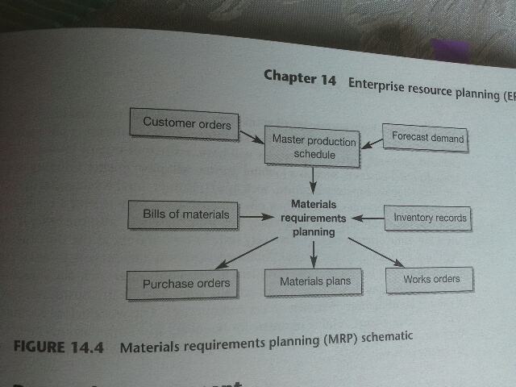
Materials requirements planning
(Pycraft et al., 2010: 411)
)

Slide 20
MRP Calculations
At its core, MRP is a systematic process of taking planning information and calculating the volume and timing requirements which will satisfy demand.
(Pycraft et al., 2010: 419)

Slide 21
Manufacturing resource planning (MRPII)
Oliver Wight, defined MRPII as “a game plan for planning and monitoring all the resources of a manufacturing company: manufacturing, marketing, finance and engineering. Technically it involves using the closed-loop MRP system to generate financial figures”
(Pycraft et al, 2010: 422)

Slide 22
Enterprise resource planning (ERP)
Enterprise resource planning (ERP) – The integration of all significant resource planning systems in an organisation that, in an operations context, integrates planning and control with the functions of business.
(Pycraft et al., 2010: 422)

Slide 23
Web-integrated ERP
Web-integrated ERP – Enterprise resource planning that is extended to include the ERP type systems of other organisations such as customers and suppliers.
(Pycraft et al., 2010: 426)

Slide 24
MNO3701 Part II Topic 5
Chapter 15
What is lean and Just-in-time? (p435)
The lean philosophy (p438)
JIT techniques (p443)
JIT planning and control (p448)
JIT in service operations (p452)
JIT and MRP (p453)
Summary (p456)

Slide 25
What is lean and just-in-time?
Just-in-time (JIT) – A method of planning and control and operations philosophy that aims to meet demand instantaneously with perfect quality and no waste.
(Pycraft et al., 2010: 435)

Slide 26
The lean philosophy
Eliminate waste
  Seven forms of waste
    Over-production
    Waiting time
    Transport
    Process
    Inventory
    Motion
    Defects
  The 5S’s
    Sort (Seiri)
    Straighten (Seiton)
    Shine (Seiso)
    Standardise (Seiketsu)
    Sustain (Shitsuke)
    (Pycraft et al., 2010: 438 – 439)

Slide 27
JIT techniques
Adopt basic working practices
  Discipline
  Flexibility
  Equality
  Autonomy
  Development of personnel
  Quality of working life
  Creativity
  Total people involvement
Design for ease of processing
Emphasise operations focus
  Learning to focus on each process on a limited, manageable sets of products, technologies, volumes and markets;
  Learning to structure operations objectives and those of all supporting services so that they are focused and coherent rather than being inconsistent and conflicting
Use small, simple machines
Layout for smooth flow
Adopt total productive maintenance (TPM)
Reduce setup times
Ensure visibility
Adopt JIT through the supply chain
(Pycraft et al., 2010: 443 – 446)

Slide 28
JIT Planning and control
Kanban – Japanese term for cart or signal: it is a simple controlling device that is used to authorise the release of materials in pull control systems such as those used in JIT.
    The move or conveyance kanban
    The production kanban
    The vendor kanban
  Levelled scheduling (Heijunka) – The idea that the mix and volume of activity should even out over time so as to make output routine and regular, sometimes known by Japanese term “heijunka”.
  Synchronisation
    Runners
    Repeaters
    Strangers
(Pycraft et al., 2010: 448 – 451)

Slide 29
JIT in service operations
Many of the principles and techniques of just-in-time, although they have been described in the context of manufacturing operations, are also applicable to service settings.
(Pycraft et al., 2010: 452)

Slide 30
JIT and MRP
Key characteristics of MRP | Key characteristics of JIT
Push system | Flow between stages of manufacturing is “pulled”
Orders from master schedule | Control accomplished by cards
Complex computer-based support | Decision making for operations decentralised
Highly dependent on accuracy of data | JIT is “rate based”
Fixed operations environment | JIT assumes resource flexibility and minimised lead times
 | JIT planning and control – only one part of wider JIT philosophy
(Pycraft et al., 2010: 454)

Slide 31
MNO3701 Part II Topic 6
Chapter 17
What is quality and why is it so important? (p503)
Conformance to specification (p 509)
Statistical process control (SPC) (p516)
Process control, learning and knowledge (p528)
Acceptance sampling (p531)
Summary (p534)

Slide 32
What is quality and why is it so important?
Prof D Garvin has categorised many of the various definitions into “five approaches” to quality:
  Transcendent approach
  The manufacturing-based approach
  The user-based approach
  The product-based approach
  The value based approach
Quality - Quality is consistent conformance to customers’ expectations
(Pycraft et al., 2010: 503 – 504)

Slide 33
Conformance to specification
Step 1 – Define quality characteristics of the product or service
Step 2 – Decide how to measure each characteristic
Step 3 – Set quality standards
Step 4 – Control quality against those standards
Step 5 – Find and correct causes of poor quality
Step 6 – Continue to make improvements
(Pycraft et al., 2010: 509)

Slide 34
Statistical process control (SPC)
Statistical process control is concerned with checking a product or service during its creation. If there is reason to believe that there is a problem with process, it can be stopped (where possible and appropriate) and the problem can be identified and rectified.
(Pycraft et al., 2010: 516)

Slide 35
Process control, learning and knowledge
Six Sigma – An approach to improvement and quality management that originated in the Motorola Company but which was widely popularised by its adoption in the GE Company in America. Although based on traditional statistical process control, it is now a far broader “philosophy of improvement” that recommends a particular approach to measuring, improving and managing quality and operations performance generally.
(Pycraft et al., 2010: 529)

Slide 36
Acceptance sampling
The purpose of acceptance sampling is to decide whether, on the basis of a sample, to accept or reject the whole batch.
(Pycraft et al., 2010: 531)

Slide 37
MNO3701 Part II Topic 7
Chapter 16
What is a project? (p463)
Successful project management (p466)
The project planning and control process (p467)
Network planning (p481)
Summary (p493)

Slide 38
What is a project?
A set of activities with a defined start point and a defined end state, which pursues a defined goal using a defined set of resources.
(Pycraft et al., 2010: 463)

Slide 39
Successful project management
Important factors:
  Clearly defined goals
  Competent project manager
  Top-management support
  Competent project team members
  Sufficient resource allocation
  Adequate communications channels
  Control mechanisms
  Feedback capabilities
  Responsiveness to clients
  Troubleshooting mechanisms
  Project–staff continuity
  (Pycraft et al., 2010: 466)

Slide 40
The project planning and control process
Stages of project management (planning and control)
  Stage 1 – Understanding the project environment – internal and external factors which may influence the project.
  Stage 2 – Defining the project – setting the objectives, scope and strategy for the project.
  Stage 3 – Project planning – deciding how the project will be executed
  Stage 4 – Technical execution – performing the technical aspects of the project
  Stage 5 – Project control – ensuring that the project is carried out according to plan.
  (Pycraft et al., 2010: 467)

Slide 41
Network planning
Techniques which help project managers with complex time-based projects.
  Network analysis- Overall term for the use of network-based techniques for the analysis and management of projects, for example, includes critical path method (CPM) and programme evaluation and review technique (PERT).
    Critical path method (CPM) – A technique of network analysis
    Programme evaluation and review technique (PERT) – A method of network planning that uses probabilistic time estimates.
    (Pycraft et al., 2010: 481)

Slide 42

End of Part II
Good Luck!

