Slide 1
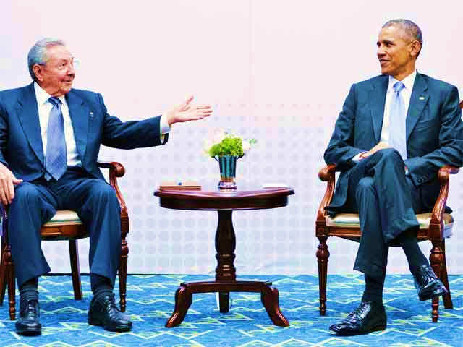
Development policy making and the role of the state
President Barack Obama met Cuban President Raul Castro on Saturday in the highest-level talks between the two countries in nearly 60 years, and the two men agreed to push ahead on improving relations after decades of hostility.
Describing their private meeting as "historic," Obama said the two countries can end the antagonism of the Cold War era, although he said he would continue to pressure the communist-led country on democracy and human rights. – 11 April 2015 - PANAMA CITY (Reuters) - U.S
“Castro said he would continue to take steps toward normalizing relations with Washington, and was open to discussing human rights and other issues. “
http://www.reuters.com

Slide 2
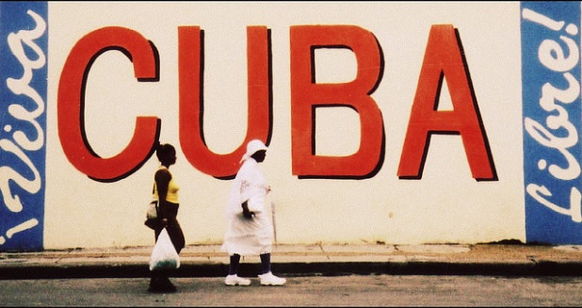
Development policy making and the role of the state
A question of balance, development planning and concepts
The rationale of development planning
The development planning process: basic models
Government failure and preference for markets
The market economy
The Washington consensus and the role of the state
Development roles of NGO’s
Trend in government reform
http://www.reuters.com

Slide 3
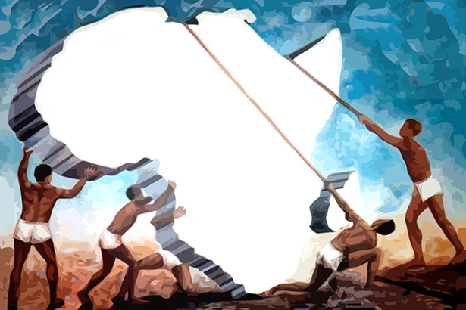
What is the important issues regarding the nature of development planning
Define economic planning
Define an economic plan
Define the planning process
Explain planning in Mixed developing economies
Predictable and sound macroeconomic policy frameworks that are supportive of inclusive growth, private sector development, employment, and value addition, are essential for Africa’s economic transformation and sustainable development.
http://www.uneca.org/our-work/macroeconomic-policy

Slide 4
The development planning process
Compare and contrast:
Aggregate growth model
Input-output analysis
Project appraisal

Slide 5
Government failure and preference for market planning
Discuss theory versus practice
Distinguish between market failure and government failure
Explain four reasons for plan failure:
Deficiencies in plans and their implementation
Insufficient an unreliable data
Unanticipated economic disturbances – internal and external

Slide 6
Mo Ibrahim index
The Mo Ibrahim Index of African governance measures the delivery of public goods and services to citizens by government and non state actors. The Ibrahim index uses indicators across four main categories:
Safety
Rule of law
Participation in human rights
Sustainable development
Scored 0- 100 where 100 is best
Mauritius is ranked no 1 ( 81.8), South African is ranked no 5 (70.2) and Zimbabwe is ranked no 50 (31.9)
http://www.moibrahimfoundation.org/

Slide 7
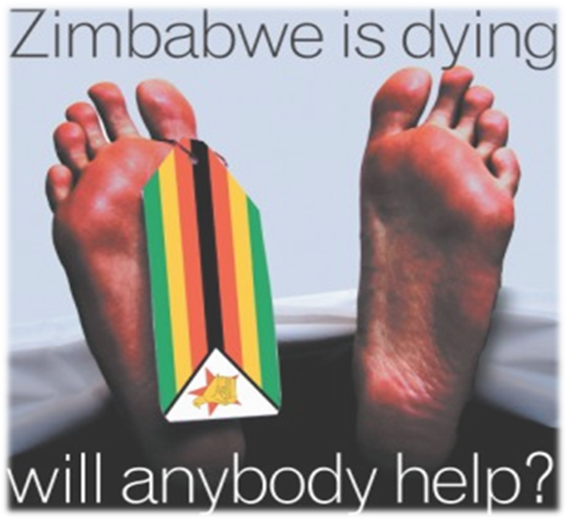
Zimbabwe is dying, and ranked 46th overall according to the Ibrahim index. Discuss problems of plan implementation and plan failure.
www.mattward.com

Slide 8
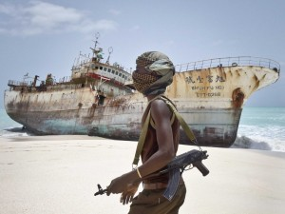
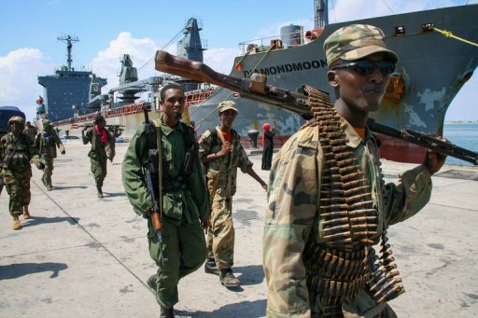

Somalia is ranked no 52 (8.6) overall on the Ibrahim index of African governance. The civil war is going on for nearly 25 years and the country obtained a 2.2 score for public management!
In your view are the development policies of Somalia broadly inline with those suggested in Washington and Santiago consensus. Substantiate your answer.
http://www.en.starafrica.com/news/somali-warlords-fight-over-key-southern-port.

Slide 9
The “Washington Consensus” on the State in Development
Towards a new consensus
  New emphasis on government's responsibility toward poverty alleviation
  Importance of health and education
  A recognition that markets can fail
  Governments can secure conditions for an effective market based economy

Slide 10
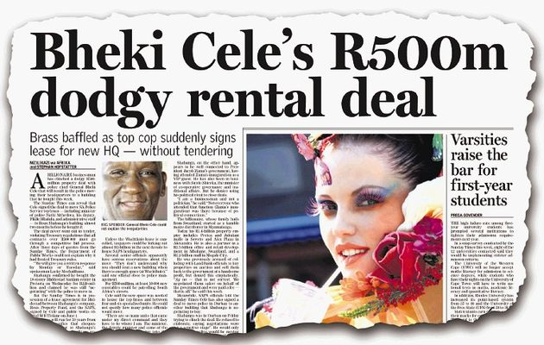
One of the indicators used in the Ibrahim index is accountability and corruption. South African is ranked 4th (67.4) on the list with Botswana 1st at (77.3). South Africa has experienced a -3.9% change over a period of 5 years a (Score 0- 100 - where 100 is best)
http://www.timeslive.co.za/politics/2012/05/27/how-we-nailed-cele
Explain what South Africa can do about the rising problem of corruption..

Slide 11
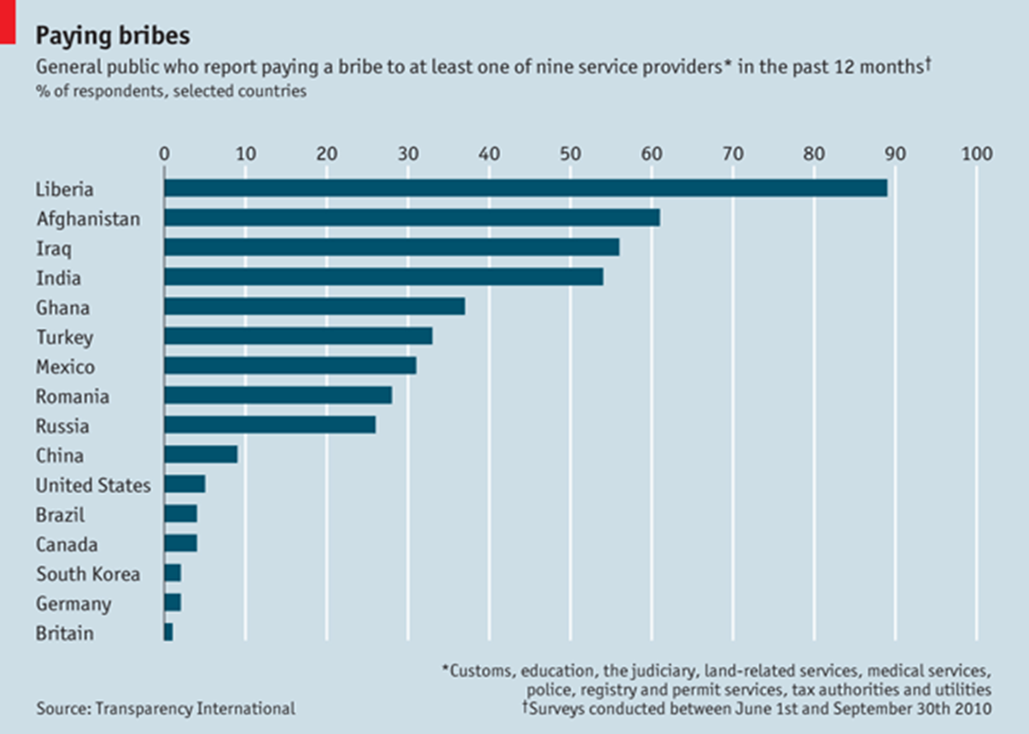
https://www.transparency.org/

Slide 12
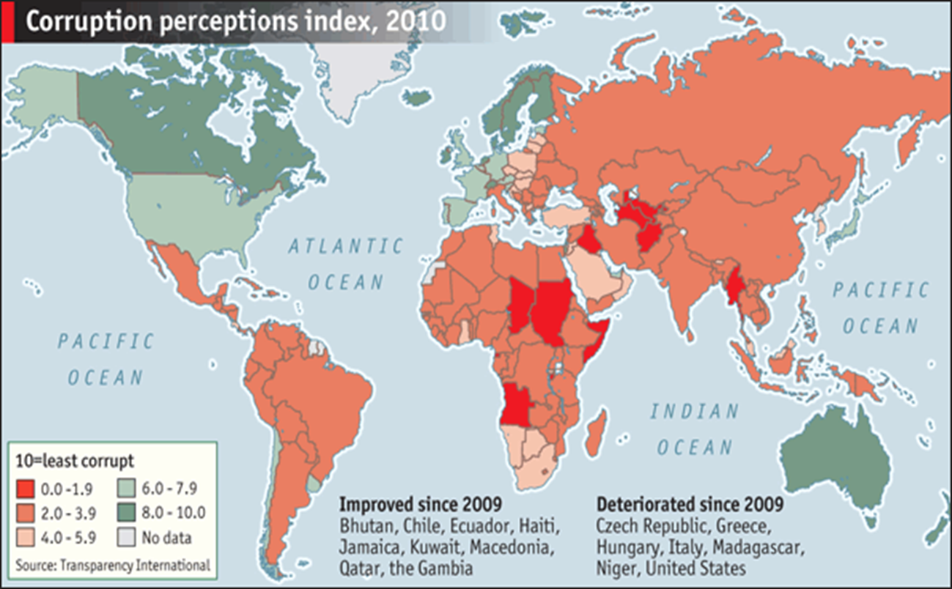
https://www.transparency.org/

Slide 13
PREPARATION FOR THE EXAM
Section A: Compulsory question
Section B: 4 Questions – you have to do 3
(of 20 marks each)
Development Policymaking and the roles of market, state and civil society
will always be tested in the Exam

