Slide 1
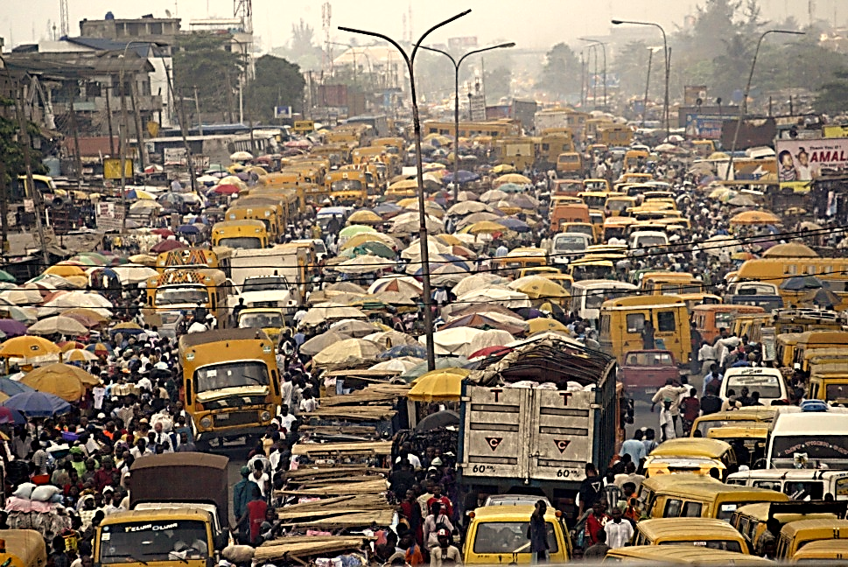
Unit 6: Urbanisation and Rural-Urban Migration: Theory and Policy
http://africanarguments.org/2012/02/22/diary-whatever-happened-to-africa%E2%80%99s-rapid-urbanisation-%E2%80%93-by-magnus-taylor

Slide 2

The migration and urbanisation dilemma
Urban bias
Rural-urban migration
The role of cities
The urban informal sector
Economic theory of rural-urban migration
Urban giantism
Todora migration model
Harris-Todaro migration model
http://www.unhcr.org/4ae6cb069.html

Slide 3
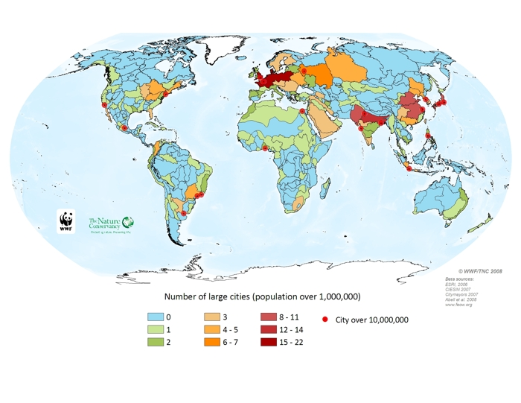
Mega cities in the world
http://www.feow.org/maps/threat/large_cities_and_megacities

Slide 4
The role of cities
Agglomeration economies: Urbanization (general) economies, localization (industry or sector) economies
Saving on firm-to-firm, firm-to-consumer transportation
Firms locating near workers with skills they need
Workers locating near firms that need their skills
Firms benefit from (perhaps specialized) infrastructure
Firms benefit from knowledge spillovers in their and related industries
(Also: consumers may benefit from urban amenities

Slide 5
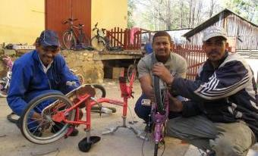
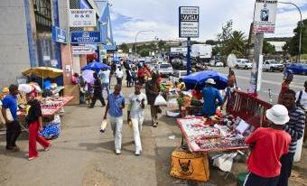
The urban informal sector
Generates surplus despite hostile environment
Creating jobs due to low capital intensity
Access to (informal) training, and apprenticeships
Creates demand for less- or un- skilled workers
Uses appropriate technologies, local resources
Recycling of waste materials
More benefits to poor, especially women who are concentrated in the informal sector
http://led.co.za/topic/informal-economy

Slide 6
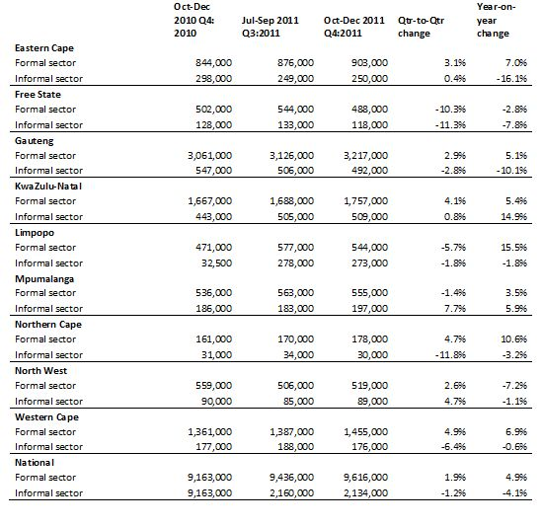
Formal and informal sector employment by province, quarter 4: 2010- quarter 4: 2011
http://led.co.za/story/2012/02/22/eastern-cape-shows-largest-informal-sector-employment-figures

Slide 7

Migration and development
Rural-to-urban migration was viewed positively until recently
The current view is that this migration is greater than the urban areas’ abilities to:
Create jobs
Provide social services
http://www.un.org/en/ga/68/meetings/migration/

Slide 8
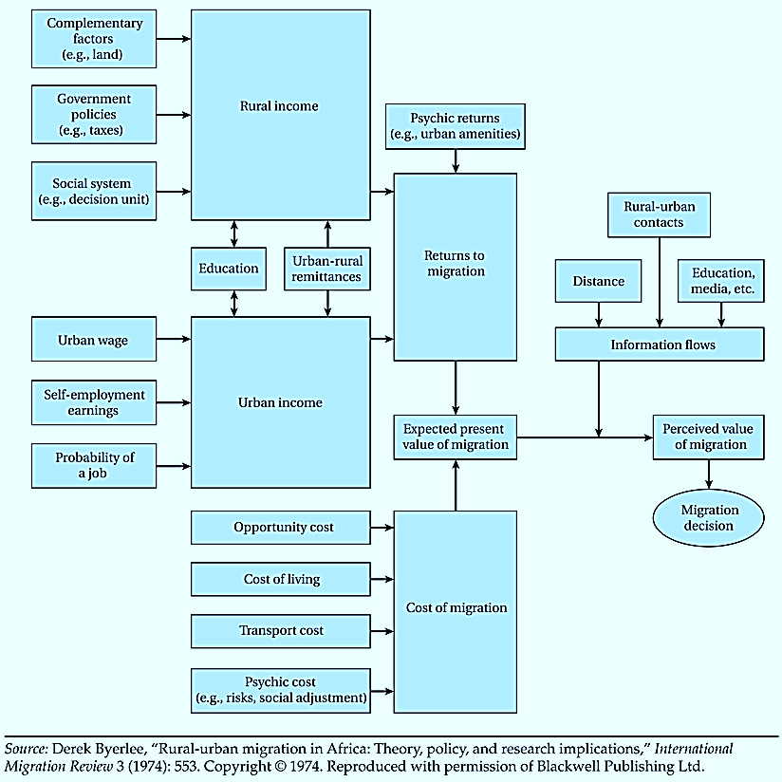
Towards an Economic Theory of Rural-Urban migration

Slide 9
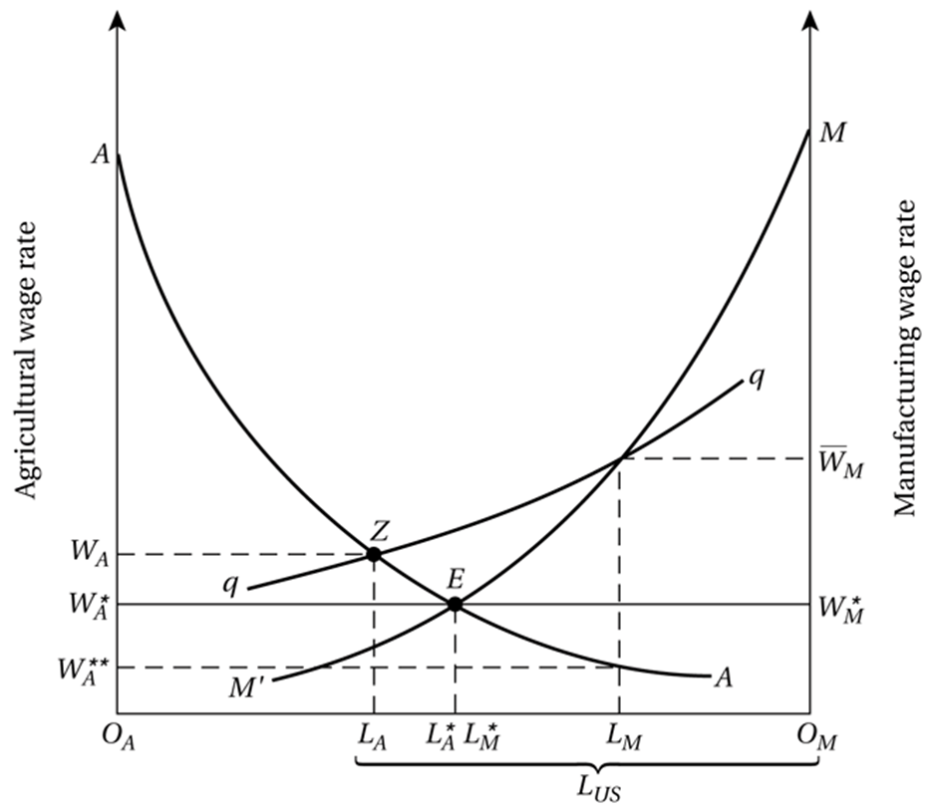
The Harris-Todaro Migration Model
Copy right@2012 Addison-Wesley – Pearson. Todaro and Smith : Economic Development

Slide 10
A comprehensive migration and employment strategy
Create a urban-rural balance
Expand small-scale, labor intensive industries
Eliminate factor price distortions
Choose appropriate labor-intensive technologies of production
Modify the linkage between education and employment
Reduce population growth
Decentralize authority to cities and neighborhoods

