Slide 1

Unit 4: Population growth and economic development
theguardian.com, Monday 18 July 2011 11.30 BST
What impact does population growth have on development? Photograph: Yoshikazu Tsuno/AFP/Getty Images

Slide 2
Some issues
The demographic transition
The causes of high fertility in developing countries
The consequences of high fertility
Goals and objectives: towards a consensus
Some policy approaches

Slide 3
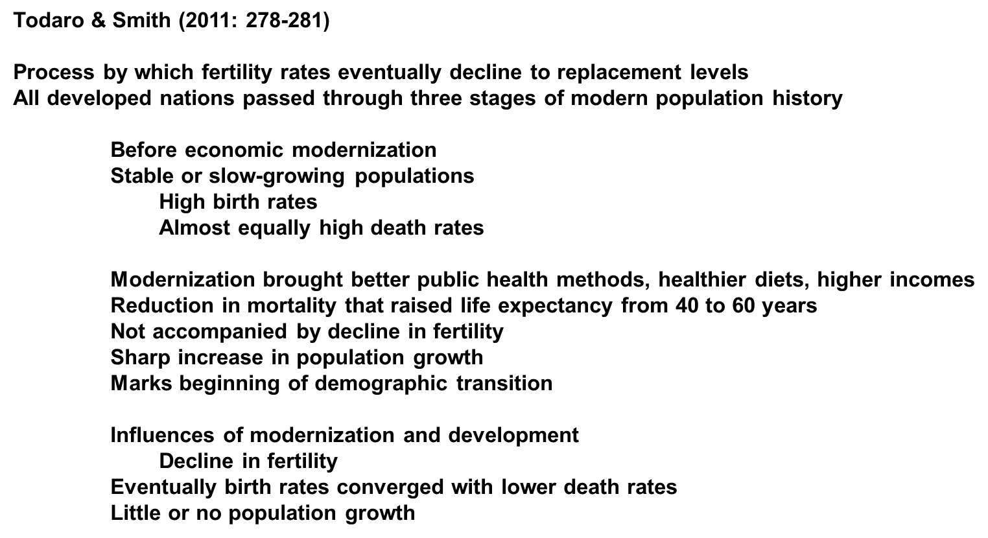
The demographic transition

Slide 4
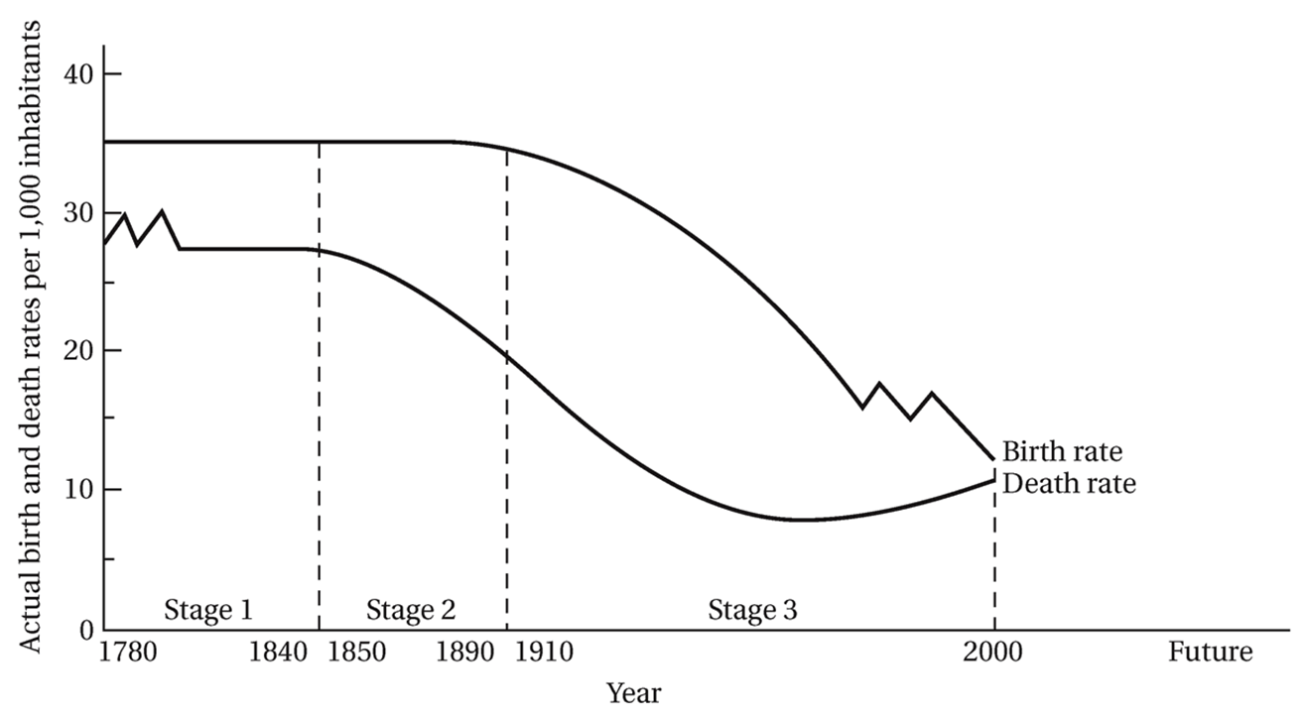
The demographic transition in developing countries
Figure 6.6 Todaro and Smith (2011:280)

Slide 5
Developing countries
Fall into two patterns
Birth rate today still much higher than in pre-industrial Western Europe
Women marry younger: more years to have children
Imported modern medical & public health technologies
Death rates fall much more rapidly than in 19th century Europe
Most developing countries in stage 2 in 1940s – 1960s
Stage 2 characterised by growth rates at more than 2% per annum
Stage 3: 2 classes
Case A:
Modern methods of death control and & rising living standards – both death rates and birth rates fell rapidly
Entered stage 3 with falling rates of population growth
Taiwan, South Korea, Costa Rica, China, Cuba, Chile, Sri Lanka
Case B:
Initial period of declining death rates – no further decline (because of poverty, low levels of living, AIDS)
Continuance of high birth rates
Population growth rate high
Many in SSA & Middle East still in stage

Slide 6
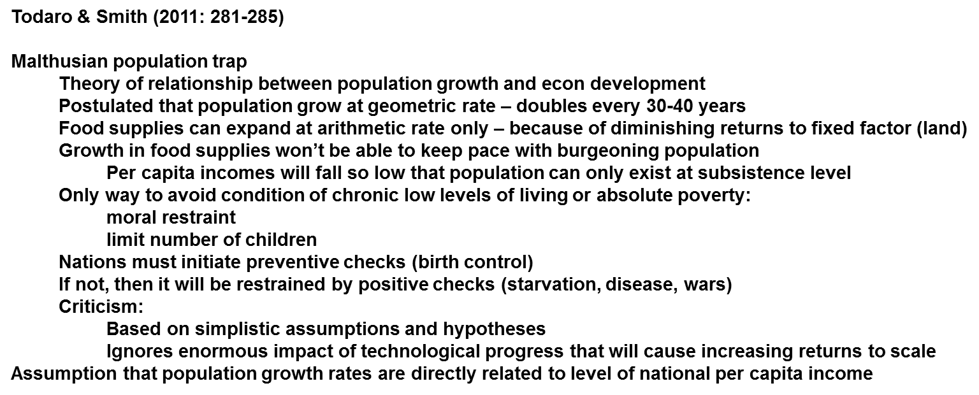
The causes of high fertility in developing countries: The Malthusian and Household models
The Malthusian population trap

Slide 7
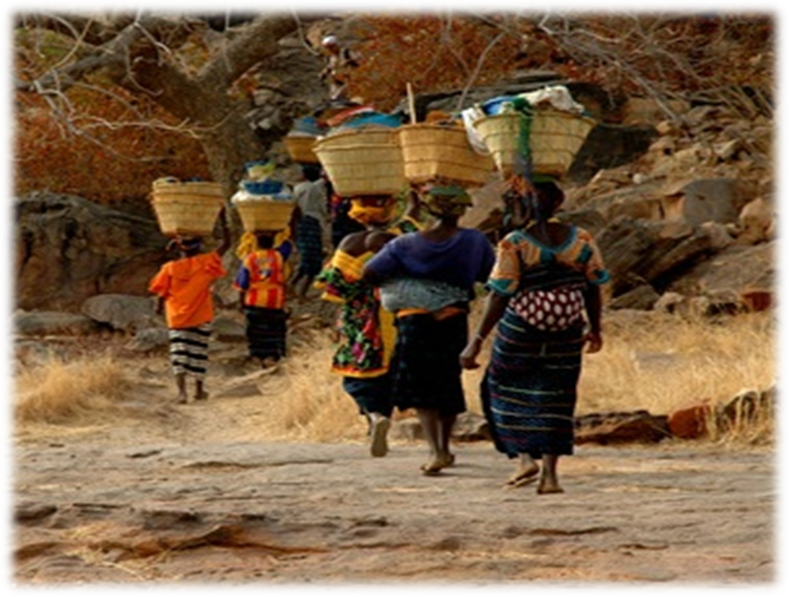
The microeconomic household theory of fertility

Slide 8
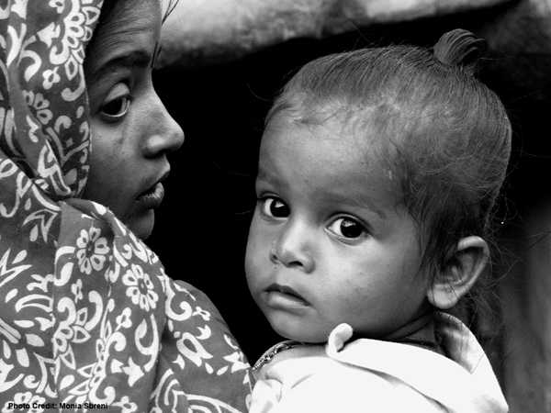
Microeconomic theory of fertility: an illustration
Draws on traditional neoclassical theory of household and consumer behaviour
Children are considered as consumption goods
Fertility now a rational response to consumer
demand for children relative to other goods
Usual income and substitution effects apply
Desired number of children is expected to:
Vary directly with household income
Vary inversely with cost (price) of children
Vary inversely with strength of tastes for
other goods relative to children
Photo by: Monia Sbreni
Source:http://www.imow.org/wpp/stories/viewStory?storyId=1383

Slide 9
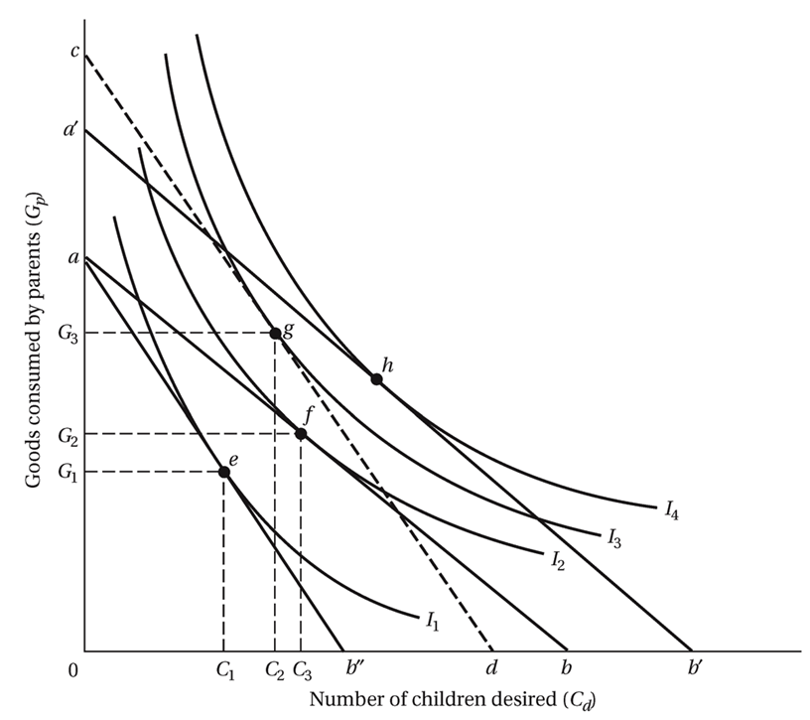
An illustration: Figure 6.9
Source: Todaro and Smith (2011:287)

Slide 10
Explanation
Fig 6.9 diagrammatic presentation
Household desire for children expressed in indifference map
Shows degree of satisfaction derived from various combinations of commodities and children
Household ability to “purchase” alternative combinations shown by budget line ab
Steeper slope of budget line if price of children higher relative to goods
Optimal combination at f
Rise in family income – budget line to a’b’
Can consume more of both at point h
Higher opportunity cost of children – point e
Simultaneous increase in income and child price
Budget line to cd – less children
First 2-3 children consumer goods
Not responsive to price changes
Psychological or cultural reasons
Decision to have additional children
Parents weigh private economic benefits against private costs
Benefits:
Expected income from child labour
Eventual financial support

Slide 11
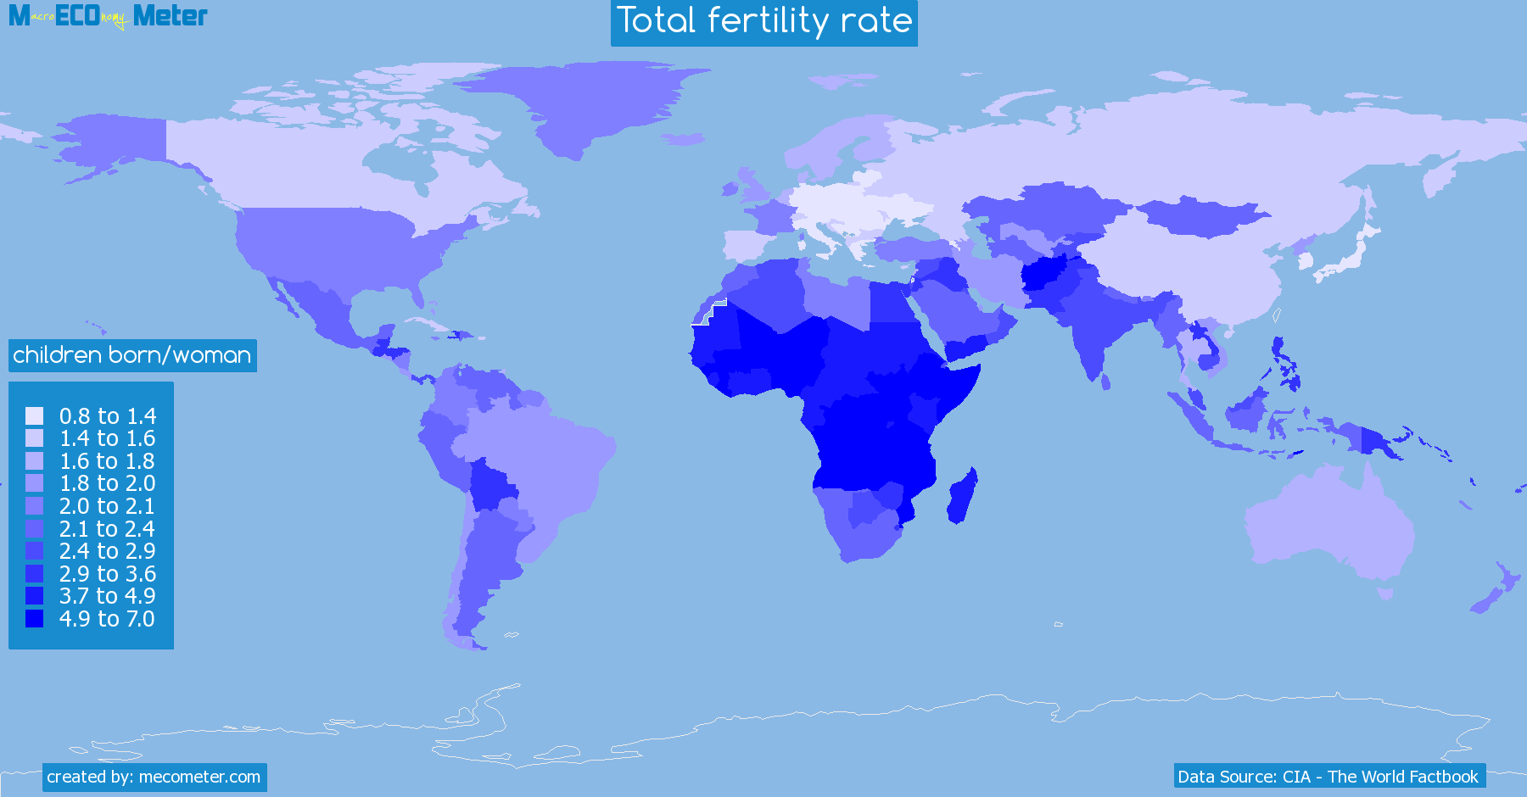
Total fertility rate by country
Source: http://mecometer.com/topic/total-fertility-rate/

Slide 12
Conflicting perspectives: Development consequences of high fertility
Todaro & Smith (2011: 290-296)
Rapid population growth is not a real problem
Other issues are the problem
Underdevelopment
World resource depletion & environmental destruction
Population distribution
Subordination of women
Deliberately contrived false issue
Rich nations want to keep status quo
Actually desirable phenomenon
To provide consumer demand
To lower production cost
Provide low cost labour supply
Many rural regions are under-populated

Slide 13
Some conflicting ideas
Extremist argument
Population growth is regarded as the principal cause of poverty, low levels of living, malnutrition, ill health, environmental degradation
Population-poverty-cycle
Prospects for better life retarded by reduced saving
Limited government revenues can provide only rudimentary services
Widespread poverty, low levels of living → cause larger family size → retard economic growth
Empirical argument
Lowers per capita income growth
At household level – leads to poverty and inequality
Restrict parents’ ability to educate all their children
Harms health of mother and children
Difficult to feed all
Contributes to environmental degradation

Slide 14
Goals and objectives: Toward a consensus
Todaro & Smith (2011: 297-298)
Make sure that you can also state the three goals or objectives for population policies that follow from this consensus opinion.
Four components of consensus opinion:
Population growth is not the primary cause of the problems of developing countries.
The population problem is not simply about numbers, but also involves the quality of life and material well-being.
Rapid population growth does intensify problems of underdevelopment.
Many population problems are the result of the concentration rather than the overall number of people.

Slide 15
Some policy approaches
Todaro & Smith (2011: 298-302)
Three sets of policy approaches for reducing population growth in developing countries:
• Policies that the developing countries can apply. Policies that readily come to mind are family-planning programmes, persuasion through the media and education, and state coer­cion through legislation and punishment. Recall, however, that the microeconomic household theory of fertility suggests that there may be sound economic reasons why low-income parents choose to have many children. For this reason, there is also scope for policies using economic incentives and disincentives to discourage large families, appropriate migration policies and policies to raise the social and economic status of women. Finally, the textbook highlights the strong downward impact that other development policies aimed at raising stan­dards of living have on population growth rates.
• Policies that the developed countries can apply. In considering the depletion of natural resources, we should not lose sight of the intensive use of natural and energy resources in developed countries and rich communities in developing countries. Natural resource deple­tion is not simply a matter of population growth in developing countries. Rich countries and the rich in developing countries should look at ways to reduce their high demand for scarce resources and its negative impact on the natural environment.
• Policies through which developed countries can assist developing countries with their popula­tion programmes. Such policies include general development assistance, as well as research and financial assistance related specifically to population programmes

Slide 16
Examination preparation
Essay questions
Diagrams and equations
Definitions
Describe …..
Explain …….
Work through all the question in the Study guide

