Slide 1
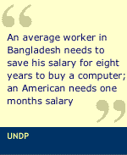
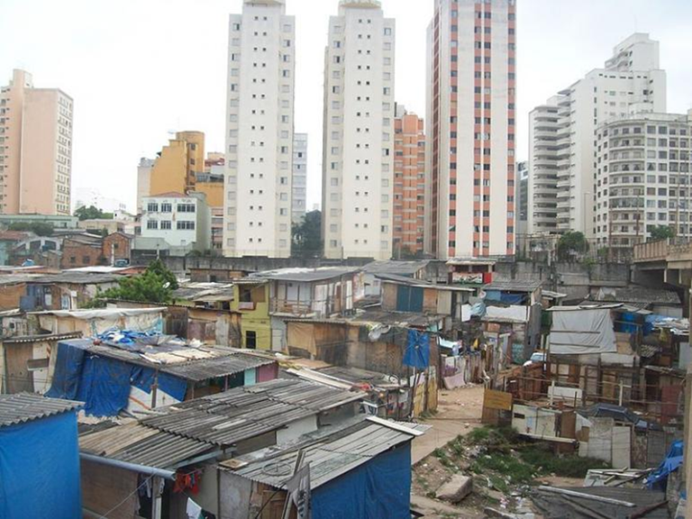
Study unit 3 – Poverty, inequality and development
Favela do Moinho, Brazil Slum. The shantytown Moinho stands next to the skyscrapers in central Sao Paulo. Source: www.Ibtimes.com
Favelas Moved for World Cup and Olympics – Rio Times, 2012

Slide 2
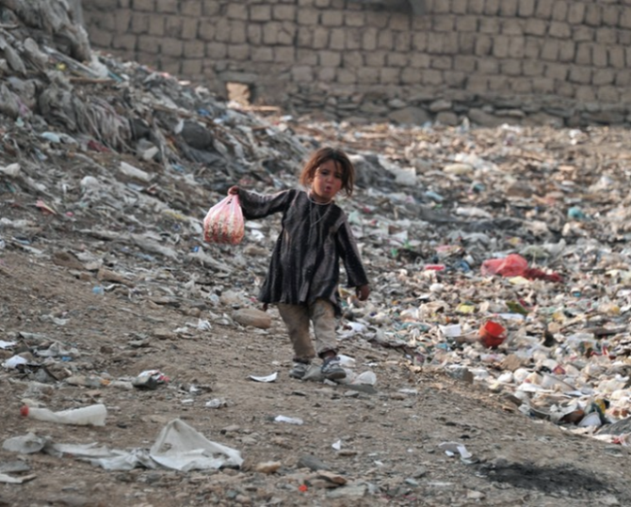
Poverty, inequality and development
Measuring inequality and poverty
Inequality and poverty in South Africa
Poverty, inequality and social welfare
Absolute poverty: extent and magnitude
Economic characteristics of poverty groups
The range of policy options
One in four children in the world live in absolute poverty.
Increase in the global population struggling to Survive Daily on Less than $2 a Day
www.bbc.co.uk -Week in pictures: 14-20 December 2013

Slide 3
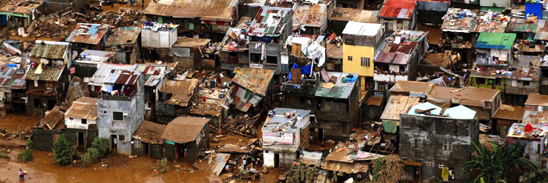

Absolute poverty
Urban poverty & slums in Mexico, www.poverties.org
Difficult to estimate, varies around the developing world
Depends on two factors:
Average level of national income
Degree of inequality in its distribution
Less than PPP $1:
9.1% of East Asia & Pacific
8.6% of Latin America & Caribbean
1.5% of Middle East & North Africa
31.7% of South Asia
41.1% of Sub-Sahara Africa

Slide 4
Measuring inequality and poverty
Concepts:
Personal distribution of income – size distributions
Quintile
Decile
Income inequality
Lorenz curve
Gini coefficient
Functional distribution of income
Absolute poverty
Head count index
Total poverty gap
Multi-dismensional poverty index

Slide 5
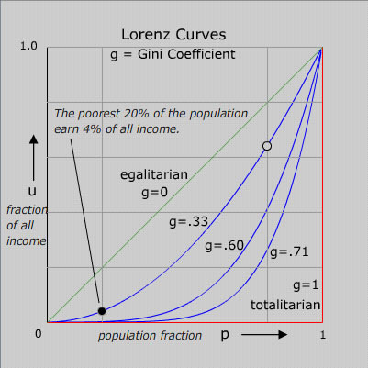


The Lorenz curve
A set of idealized Lorenz curves are shown in the figure. The sloping straight green line is the Lorenz curve of an idealized perfectly egalitarian society - where everybody has exactly the same income. The red Lorenz curve - horizontal and then vertical - is that for the extreme authoritarian or totalitarian society where one person has all the income. Curves for societies with intermediate income distributions are shown. To clarify the meaning of the curves, the significance of one point (black) on one of the curves is displayed. The open circle point on the same curve has the coordinates: 80% of the population earns 64% of the income. Or, what is equivalent, the richest 20% of the population earns 36% of the income.
D
A
Source: http://www.physics.ucla.edu/~chester/GINI/

Slide 6
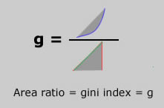

The Gini coefficient
Quite simply the Gini index amounts to a ratio of two areas derived from the Lorenz plot: that between the green and the blue curve divided by the area of the triangle made by the green and the red curve. Here is a picture of the idea.
The Gini Index is zero (full equality) when everyone in the society earns exactly the same as everyone else. In a thoroughly totalitarian society, where all earn nothing except for the leader who earns everything, the Gini Index is 1 (or 100%). Needless to say, no country exists with Gini Index zero or one. Since the extremes are evidently unstable - they cannot persist - there must be an optimum GINI! What principle governs the optimization? I confess to not knowing. In the real world the Index ranges between about .25 (25% or just 25 in the published tables) to .70 (70 in tables).
A list of the gini indices for most of the countries of the world is given by the Central Intelligence Agency in its World Factbook.
g =
_____
BCD
Source: http://www.physics.ucla.edu/~chester/GINI/

Slide 7
Lorenz curve and gini coefficient
Work through Activity 1 of Study unit 3
YOU MUST BE ABLE TO:
construct and explain a Lorenz curve
explain the derivation of the gini coefficient.
calculate cumulative distributions of income.
describe the measurement of absolute poverty, headcount index and the total poverty gap.

Slide 8
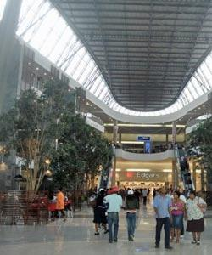
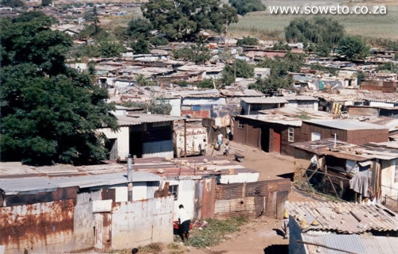
Inequality and poverty in South Africa
Today, almost half of South Africans are living below the poverty line, surviving on just over R500 a month - an improvement from 1993.
And this is only part of the dilemma we face in South Africa, because while poverty levels decline, inequality has increased
Poverty and inequality in South Africa
16 Sep 2011, www.mg.co.za
Maponya Mall is by far the most upmarket of the malls in Soweto. www.joburg.org.za

Slide 9
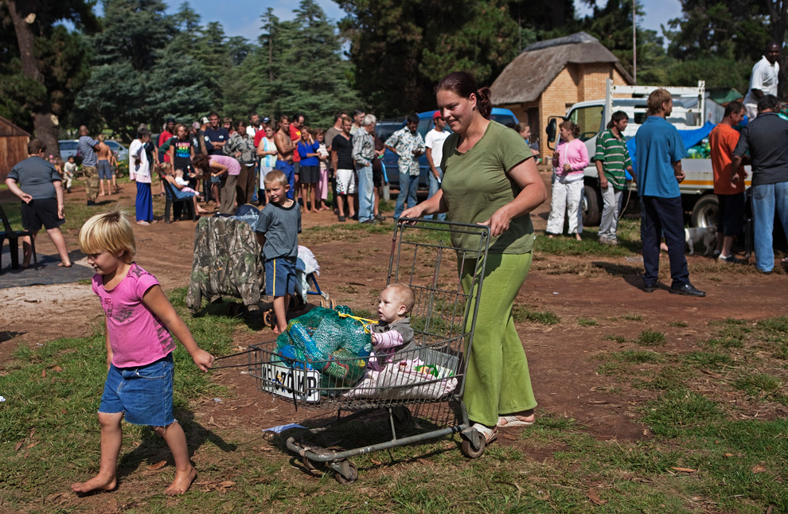
Inequality and poverty in South-Africa – SEE Study unit 3
Describe the extent and nature of poverty in South Africa since 1994.
Your answer must reflect facts and statistics
Avoid politics and sentiments
A woman pushes a cart with a monthly supply of donated food aid at Coronation Park in Krugersdorp, March 6, 2010. (REUTERS/Finbarr O'Reilly)

Slide 10
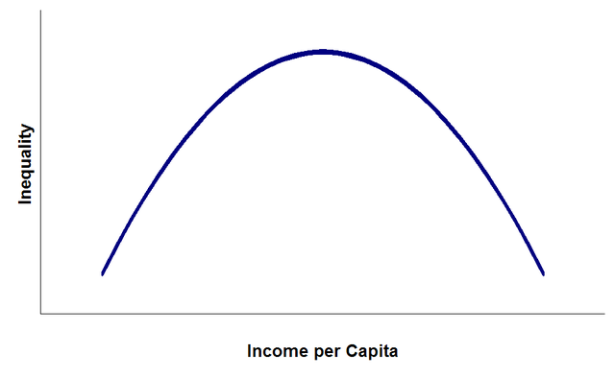
Poverty, inequality and social welfare
Kuznets’s inverted – U hypothesis
www.economics-exposed.com/kuznets-inverted-u-curve/
According to Kuznets, in the initial stages of economic development, the income distribution is worsened, but in the later stages it is improved

Slide 11
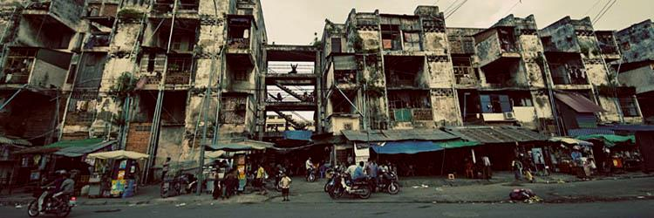
Absolute poverty: extent and magnitude
Urban poverty and slums in Cambodia – www.poverties.org - What is Poverty ?
The Stakes of a Good Definition
What is poverty… according to Encyclopaedia Britannica (2008):
“The state of one who lacks a usual or socially acceptable amount of money or material possessions. […] Whatever definition one uses, authorities and laypersons alike commonly assume that the effects of poverty are harmful to both individuals and society."
That’s also the reason why the World Bank is now a self-proclaimed world fighter against poverty, with its slogan: “Our dream is a world free of poverty”. The UN as well has its own program aimed at reducing “by half, between 1990 and 2015, the proportion of people whose income is less than $1 a day”: the Millennium Development Goals. So… let’s observe the connection between the question "What is poverty?" and the notion of economic development.

Slide 12
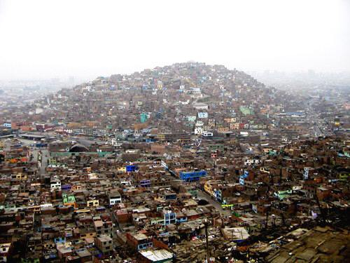
Economic characteristic of poverty groups
• Race:
Poverty is concentrated among Blacks and Coloureds. These groups experience higher rates of poverty than Indians and Whites.
• Location:
Poverty is widespread and acute in rural areas, followed in declining order by small towns, secondary cities and metropolitan areas.
• Level of education:
People with little or no education are likely to live poverty than those with secondary and tertiary education.
• Employment status:
Poverty and unemployment are closely related. Unemployment rate from poor households is high as compared with non-poor house­holds.
• Gender of household head:
The incidence of poverty in female-headed households is high as compared with male-headed households.
Pueblo Joven (shanty town) in Lima, Peru
www. chinasouthamerica.com

Slide 13
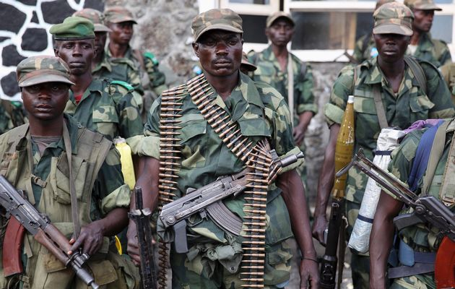
The range of policy options
Dictatorships retard Africa's development: iLIVE, Lonwabo Busakwe, Khayelitsha , www.timeslive.co.za
Changing size distribution through progressive redistribution of asset ownership.
Reduce size distribution at upper levels through progressive income and wealth taxes.
Direct transfer payments and public provision of goods and services.
May be useful to impose a work requirement before food aid is provided.
Changing the functional distribution of income by changing relative factor prices .

Slide 14
Examination preparation
Definitions
Calculations
Diagrams
Essay type questions

