Slide 1
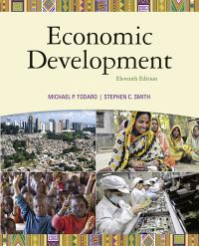
DEVELOPMENT ECONOMICS ecS 3707
2014 ONLINE

Slide 2
PRESCRIBED TEXTBOOK:
Todaro, MP and Smith, SC. Economic Development, 2011. 11th edition. (Addison-Wesley is an imprint of) Pearson Educatation Limited: United Kingdom
ECS3707 is an ONLINE module –study material is available electronically on- myUNISA
Any UNISA study material obtained from sources other than the official prescribed material, official UNISA study material and myUNISA should be avoided.
Please be aware of: www.togetherwepass.co.za – you will pay for material you already have

Slide 3
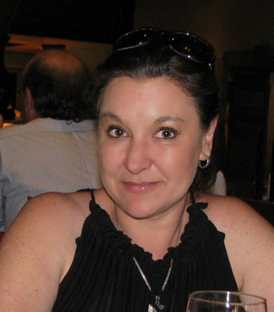
Development Economics ,ECS3707
Online
Why are some countries rich and others poor? Ever since Adam Smith wrote "The Wealth of Nations" in 1776 this question has been on the mind of many economists. This module takes a look at “how the other half lives”. http://www.eoi.es/ millennium-development-goals-for-sub-saharan-africa
This is a module covers all the major issues and developments in the field of development economics. We will take you to the core of the discipline, covering recent research as well as more established material.
About the Module leader: Reinet Lötter
Reinet Lötter is the module leader for Development Economics
ECS3707G.
Qualifications: B Com Economics, University of Pretoria
B Com Economics (Hons), University of Pretoria
M Com Economics PU (CHE)
She has more than 20 years experience in her field. Her field of interest and research includes growth theories, the convergence hypothesis, microeconomics and health economics.

Slide 4
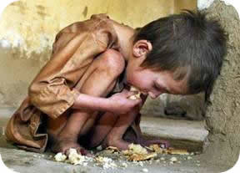
Study unit 1
Todaro: Chapter 1 and 2
Development and development economics
The nature of economic development
The important role of values in development
Economies as social systems
What is meant by development
The human development index
http://wphr.org/wp-content/uploads/2011/03/poverty2.jpg
Life in the area is so precarious that the youth and every able person have to migrate to the towns or join the army at the war front in order to escape the hazards of hunger escalating over here.
—Participant in a discussion group in rural Ethiopia

Slide 5
The nature of development economics
The following questions need to be asked about a country’s development: Have there been any changes in the country’s poverty levels? Have the unemployment levels changed? What about inequality? If all three of these have declined from high levels, then there has been a definite period of development in the country concerned. If one or two of these central problems have worsened, especially all three of them, one would not really be able to call the result “development”, even if the per capita income has doubled (Todaro & Smith 2011:15).

Slide 6
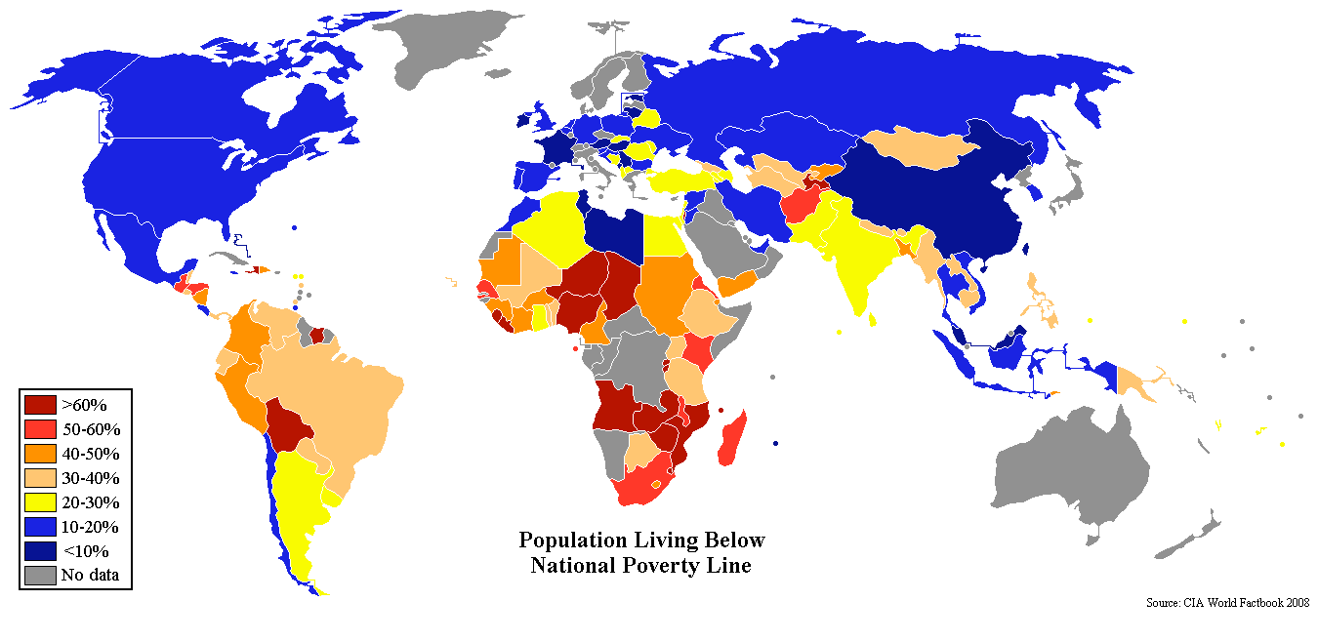
How the other half live?

Slide 7
Define
Absolute poverty
Development
Traditional economics
Political economics
Development economics
Social system
Values and attitudes
Institutions
GNI
GDP
Functioning's
Purchasing power parity

Slide 8

Sen’s capability approach
  Status of poor or non-poor is determined by capability to function
  The commodities a person has is not NB – more NB what a person is (or can be), and what he does (or can do) with the commodities he has (Sen calls it functioning’s)
  Five reasons why there may be a difference between the real income (commodities) and the advantages derived (functioning’s):
    Personal differences (disability, age, gender)
    Environment (temperature, tropics, pollution)
    Social conditions (crime, violence)
    Relational perspectives (poorer than the rest, although adequate income)
    Distribution in family (girls vs boys)
  Defines capabilities as the freedom of a person in terms of the choice of functioning’s, given his personal features and command over commodities
  Human well-being
    being well, sense of happiness
    financial security only one factor affecting happiness
http://philosophersforchange.org/2012/02/06/global-economic-justice/http://philosophersforchange.org/2012/02/06/global-economic-justice

Slide 9
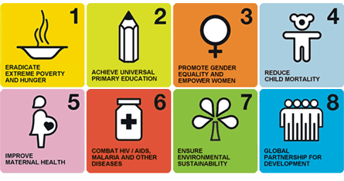

The Millennium Development Goals
The facts about poverty and inequality in the developing world are well known. Poverty is endemic and debilitating in many parts of Asia, Africa, and Latin America. There has been some progress on poverty, not on inequality in the past decade, and much of the progress on poverty has occurred in China. There is famine in Africa and North Korea and substantial food insecurity in many countries in Asia and Africa. There remains a very serious power imbalance within and across countries, leading to mistreatment of the poor as individuals and as populations. There is endemic predation of resources by powerful insiders in many countries — Myanmar, Brazil, and even India, for example. And there are all too many examples of governments that trample on the rights, wellbeing, and dignity of their own populations, and of powerful outsiders taking advantage of weaker countries for resources — agriculture, water, minerals
http://philosophersforchange.org/2012/02/06/global-economic-justice/http://philosophersforchange.org/2012/02/06/global-economic-justice/

Slide 10
Have South Africa eradicate extreme poverty and hunger?
How far is South Africa in ensuring that all boys and girls complete a full course of primary schooling?
Have South Africa achieved gender equality and empowered women?
Did South Africa reduced its child mortality rate?
Was there an improvement in maternal health?
Have South Africa combat HIV/AIDS
Can South Africa ensure environmental sustainability?
How far is South Africa in developing a global partnership for development?
Google: www.undp.org.za South Africa Millennium Development Goals

Slide 11
Human development index
Todaro & Smith (2011: 54-56)
Ranks all countries on a scale of 0 (lowest HDI) to 1 (highest)
Based on 3 goals of development:
Longevity (third) -Measured by life expectancy at birth
Knowledge (third) -Measured by weighted average of –
  Adult literacy (two thirds)
  Mean years of schooling (one third)
Standard of living (third)
  Measured by real GDP per capita adjusted for PPP

Slide 12
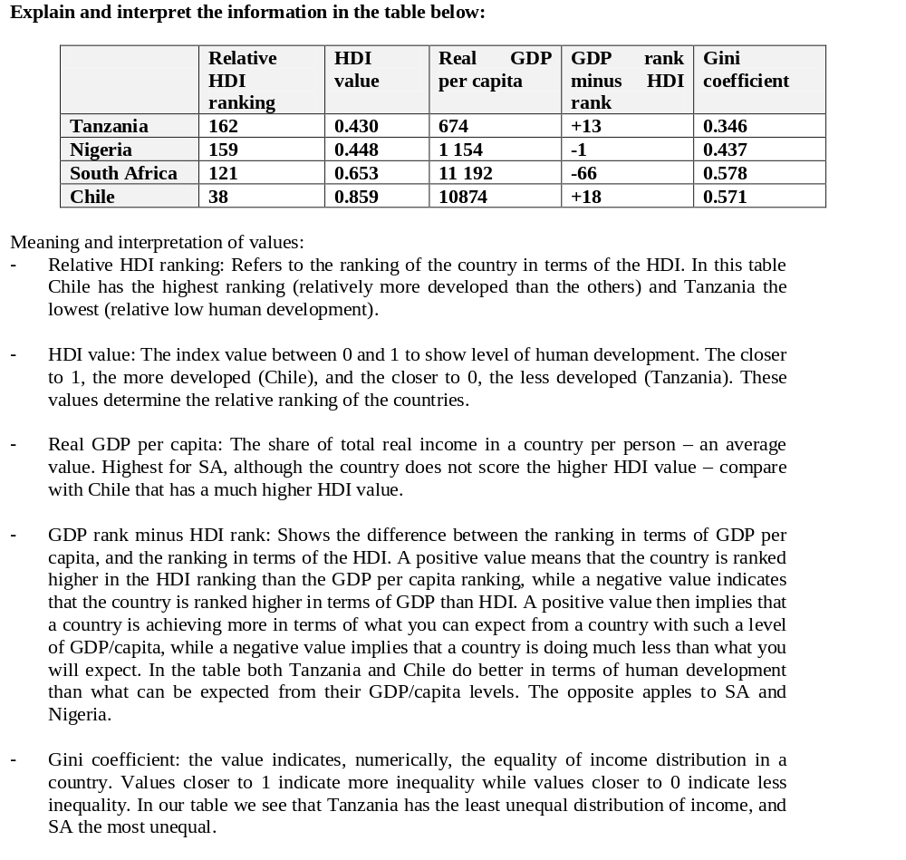
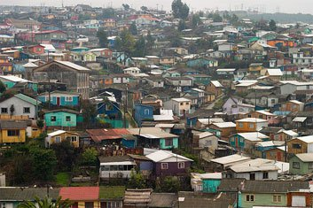
Although Chile's economy is booming, 18.7 percent of the population still lives below the poverty line.
Source: Augusto Pinochet & the Realities of the Free Market in Chile
By The Red Phoenix on May 27, 2011

Slide 13
Examination Preparation
No multiple choice questions
Work through all the questions in the STUDY GUIDE

