Slide 1
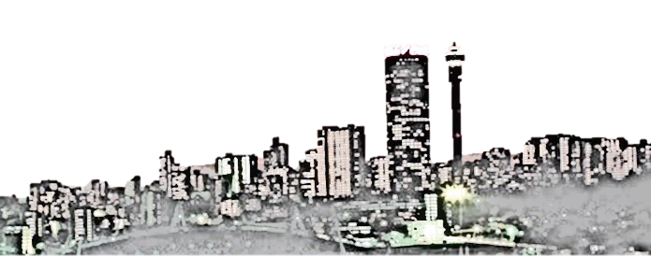
ECS 1601
Learning Unit 3
The Public Sector

Slide 2


Remember, the best way to learn is to take notes and ASK if you don’t understand.
Now you know more about the interdependence in the economy and the monetary sector. Up next, the public sector!
Take out your text book. Keep it next to you!
If the slide has a red speech bubble that says READ section so-and-so, hit pause. Read the section and watch the slide thereafter!
Please note that other words for the public sector is the government sector

Slide 3
Content
In this learning unit you will learn more about:
  The role of the government
  Government intervention
  Government failure
  Nationalisation and privatisation
  Fiscal policy and budget
  Government spending
  Financing of government spending
  Taxation
  Taxation in South Africa

Slide 4

3.1 The government or public sector
Read section 15.1 in textbook
p 276
The South African public sector consists of the following:
  Central government – concerned with national issues such as defence and foreign affairs
  Provincial (regional) government – concerned with regional issues such as housing and education
  Local government – concerned with local issues such as sewerage, roads and traffic control
  Public corporations and other government business enterprises such as Eskom and Transnet
Central, provincial and local government are referred to as the general government.
The general government and public corporations are referred to as the public sector.

Slide 5

The role of government
Read section 15.2 in textbook
pp 276 - 277
We need the government in the economy for four main reasons:
Sometimes the market outcome is not efficient, and the government has to intervene to correct such failures.
The government has to enforce certain rules to enable the private sector to do business, e.g. property rights, enforcement of contracts etc.
Markets can fail, and the government should try to correct market failures.
When markets are not fair, the government should enforce equity in society, such as helping the poor.

Slide 6


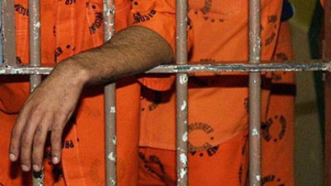

3.2 Government intervention
Read section 15.5 in textbook pp 286 - 287
The government can intervene in five ways:
Delivery of public goods and services
  Public owned and financed.
  Government pays private firm to
  deliver public good or services.
  The government ‘teams-up’ with
  a private firm, called a PPP
  (public-private partnership).
Participate in the market. The government buys goods and services and employs people.

Slide 7
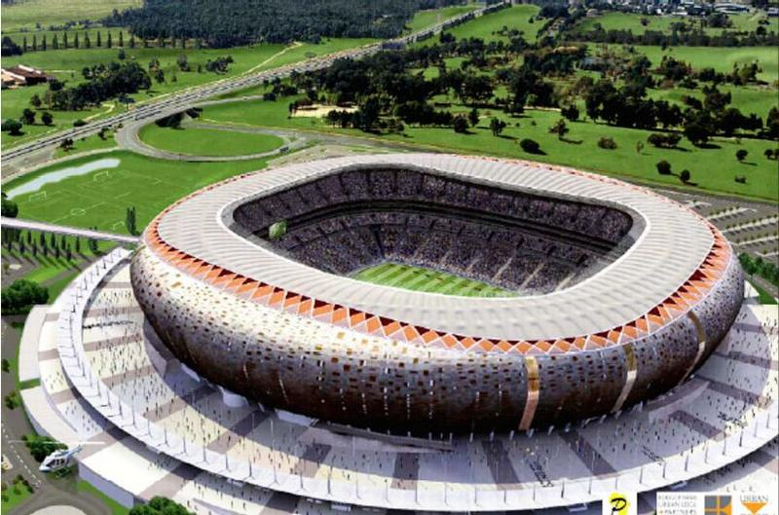
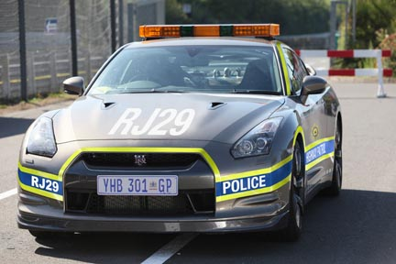
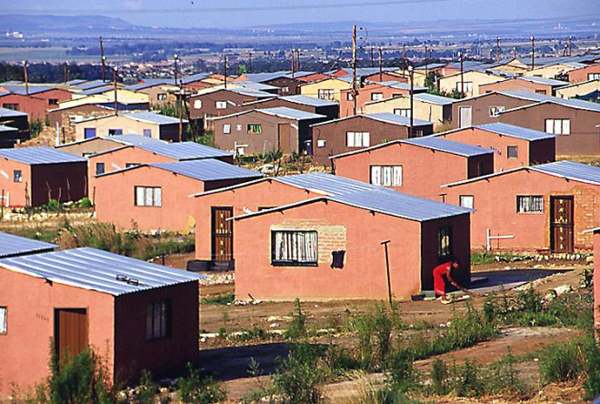
3.2 Continued
Government spending - the government can influence the economy when deciding what they want to buy. Government can make transfer payments; that is when they make a payment without receiving anything in return.
Taxation is a powerful instrument. For example, if the government wants a more equal distribution of income, they can tax the rich more and the poor less.
The government uses Regulations and laws to affect the economic outcome

Slide 8
3.3 Government failure
Read section 15.6 in textbook pp 287 - 288
Public Officials
Politicians
People who are elected to office
Bureaucrats
People who are appointed by the government
POLITICIANS CAN FAIL:
  The goal is to be re-elected; sometimes the government does the popular thing and not the right thing.
  The government wants votes in the short term! Sometimes they ignore the long-term goals.
BUREAUCRATS CAN FAIL:
  Government is not, like the private sector, in constant competition. And no competition = inefficiency!
  Example: private sector businesses knows if they provide bad service, clients will leave. But, if your are not satisfied with the bureaucrats at Home Affairs (when issuing a passport or ID), you cannot go anywhere else!
  OTHER FAILURES:
  Rent-seeking: influencing government’s behaviour to your own advantage and society’s disadvantage

Slide 9


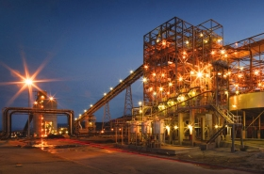
3.4 Nationalisation and privatisation
Read section 15.7 in textbook pp 288 - 289
Nationalisation means the government takes ownership of private companies.
  State-owned companies such as Eskom is NOT nationalisation!
  Important: Nationalisation is the TRANSFER of private ownership to public ownership.
Economists agree that nationalisation leads to economic failure, as it results in inefficiencies, political interferences, etc.

Slide 10


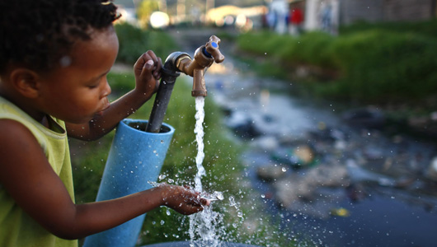

3.4 Continued
Privatisation means private companies takes ownership of public enterprises. Why?
If government expenditure decrease, then income tax can be decreased.
Private ownership is more efficient.
Inefficient state owned enterprises costs the government a lot! Privatisation relieves government from some expenditures (improve budget deficits).

Slide 11
3.4 Privatisation arguments
For
The government is good in politics and bad in business (inefficient, no innovation, unresponsive, etc.)
Privatisation attracts foreign direct investments.
Not only will the government have less expenditures, but the private company that takes the business over will pay taxes.
Against
Private firms are effective due to competition; but there will not necessarily be any competition after privatisation -this may result in a monopoly situation.
Government takes stock of external costs (pollution, environmental decay, etc.). Private firms do not.
Private firms are not concerned with the society at large (reducing poverty, increasing standard of living, taking care of the environment).
Private companies can change and adapt easily to economic circumstances
Government will have more to spend on education, service delivery, etc.
Instrument for black economic empowerment

Slide 12

3.5 Fiscal policy and the budget
Read section 15.8 in textbook
pp 289 - 290
Fiscal policy is about what the government spends, what they borrow and how they tax the public.
  Government budget: Like your personal budget, the government also has a budget.
  The budget is a political decision on how much to spend, on what to spend it and how to finance the spending.
Fiscal policy is an instrument of demand management – it can be used to regulate the total demand for goods and services in the economy.
Minister of Finance,
Nhlanhla Nene

Slide 13


3.5 Continued
EXPANSIONARY FISCAL POLICY MEANS:
If the economy is weak (recession), it is like a slow moving car:
The government should step on the petrol (meaning, they should spend more). And the economy will gain speed!
How can the government increase spending in the economy?
If income tax decreases, people will have more money in their pockets and consumption will increase!
CONTRACTIONARY FISCAL POLICY MEANS:
If the economy is doing good (high growth rates):
Government should spend less or increase income taxes because the ‘car’ (economy) is going fast enough on its own!
And you don’t want it to go TOO FAST!

Slide 14
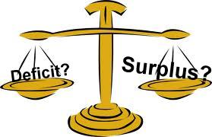
3.5 Continued
The difference between government spending and taxation is called the budget deficit/surplus
If taxes (revenues) exceeds government spending, there will be a budget surplus
If government spending exceeds taxes (revenues), there will be a budget deficit
Contractionary fiscal policy will thus restrict economic activity and decrease the budget surplus or increase the budget deficit (G decreases and/or T increases)
Expansionary fiscal policy will thus stimulate economic activity and decrease the budget surplus or increase the budget deficit (G increases and/or T decreases)

Slide 15
3.6 Government spending
Read section 15.9 in textbook
pp 290 - 292
Since 1970s, governments world wide have been spending more. This is due to:
  Changing consumer preferences
  Political and other shocks
  Redistribution of income
  Misconceptions and entitlement
  Population growth and urbanisation
Study the meaning of each of these reasons carefully and discuss it with your e-tutor.

Slide 16
3.7 Financing government spending
Read section 15.10 in textbook
pp 292 - 293
Sources of government income
Income from property
Taxes
Borrowing
Largest source but not enough to finance total G spending
Everything that is not covered by taxes, is borrowed
Borrowing from SARB is avoided – it causes inflation

Slide 17
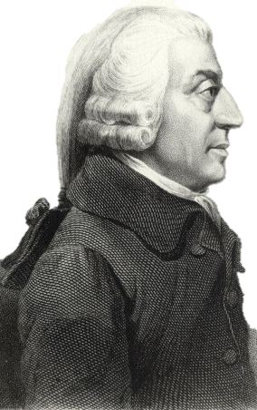
3.8 Taxation
Read section 15.11 in textbook
pp 293 - 296
Adam Smith’s criteria for a good tax:
Neutrality: A tax should disturb prices and allocation of resources as little as possible.
Equity: A tax should be spread fairly across society.
Horizontal equity: People in the same position pays the same.
Vertical equity: People in different positions pay differently.
Administrative simplicity: It should not be difficult or costly to collect the tax:
  Complicated tax systems create opportunities
  for tax avoidance (tax avoidance refers to legal ways
  to avoid taxes, tax evasion refers to illegal ways to
  avoid paying taxes).

Slide 18
Different types of tax
Major categories
Indirect taxes
Taxes on goods and services
Levied on the person
Direct taxes
Selective – on certain good and services such as ‘sin tax’ on alcohol
General – such as VAT, on all good and services
Progressive: the rich pays a larger percentage of income to taxes than the poor.
Proportional: the rich and poor pay the same percentage of income to taxes
Regressive: the rich pays a smaller percentage of income to taxes than poor
NOTE: it is about the percentage someone pays, not the amount.

Slide 19

Personal income tax
  This is tax levied on the individual’s taxable income.
  Taxable income is the legal tax base.
  The marginal tax rate is the rate at which each additional rand of income is taxed.
  The average tax rate is the ratio between the amount of tax paid and taxable income.
  Personal income tax in SA is a progressive tax
  Capital gains tax (CGT) are taxes on gains resulting from the sale of assets like shares and fixed property.

Slide 20
Company tax
  This is an example of a proportional tax rate.
Value-added tax (VAT)
  This is an example of a regressive tax rate.
  Why? Because, poor people spend a larger part of their income on items with VAT (they do not save or invest money), thus, they pay a higher percentage of their income on VAT than rich people.
Rise in overall tax burden
  Tax burden on public has increased. Crowding out means an increase in governmental spending causes a decrease in private expenditure.

Slide 21

Are you able to:
Define fiscal policy?
Name the instruments of fiscal policy?
Explain briefly why government is involved in
economic activity?
Explain how government intervenes in the economy?
Explain government failure?
Explain nationalisation and privatisation?
Explain how government spending can be financed?
Explain the criteria for a good tax?
Do you know the difference between direct and indirect taxes?
Explain the difference between progressive, proportional and regressive taxes?

Slide 22


That is the end of learning unit 3.
A quiz on this work will be available soon; make sure you do it and discuss it with your e-tutor!
Your hard
work will be rewarded in the exams.

