Slide 1
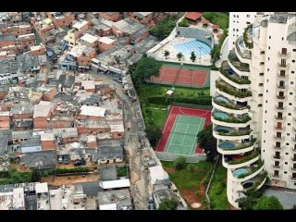
Study unit 4
Poverty, inequality and development
Chapter 5

Slide 2
Study unit 4
Measuring inequality and poverty
Inequality and poverty in South Africa
Poverty, inequality and social welfare
Absolute poverty: extent and magnitude
Economic characteristics of poverty groups
The range of policy options: some basic considerations

Slide 3
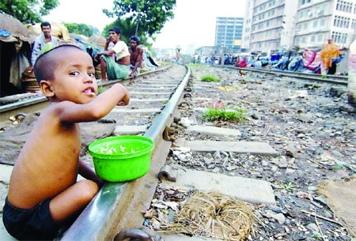
4.1 Measuring inequality and development
Two principal measures of income distribution
Size distribution
Lorenz curves
Gini coefficient
Functional distribution
Measuring poverty

Slide 4
The Lorenz curve
The following imaginary income distribution data are for Boatland.
See Todaro (2009:210 – 219)
Quintile | Percentage share | Cumulative % share
First | 3% | 3
Second | 5% | 8
Third | 7% | 15
Fourth | 10% | 25
All income groups | 100% | 100

Slide 5
The Lorenz curve

Slide 6
Lorenz curves
  Method to analyze and illustrate personal income distribution
  Horizontal axis → number of income recipients in cumulative percentages
  Vertical axis → share of total income received by each percentage of population, also in cumulative values
  Diagonal line from lower left corner to upper right corner of square
  Every point on diagonal shows percentage of income received is exactly equal to percentage of income recipients
  Diagonal line – shows perfect equality
  Lorenz curve shows actual quantitative relationship between percentage of income recipients and the percentage of income they actually received – Fig 5.1
  Lorenz curves for all countries will lie to the right of the diagonal
  The more the Lorenz line curves away from the diagonal, the more unequal the distribution of income – Fig 5.2

Slide 7
The Gini coefficient
To calculate the Gini coefficient, we are interested in the size of area A only. To calculate the inequality of the distribution of income, we want to know how big is area A in relation to the whole area to the right of the diagonal line. Therefore we calculate the size of area A as a proportion of area A+B.
Gini coefficient = A__
A + B
C
A

Slide 8
The Gini coefficient
  Summary measure of relative degree of income inequality
  Calculate ratio of the area between the diagonal and Lorenz lines, to the total area of the half-square where the Lorenz line lies – Fig 5.3
  Value varies between 0 (perfect equality) and 1 (perfect inequality)
  Countries with highly unequal distribution – between 0.5 and 0.7
  Countries with relatively equitable distribution – varies between 0.2 & 0.35
  As a measure it satisfies four desirable properties:
    Anonymity principle – does not depend on who has the higher income
    Scale independence principle – does not depend on size of economy
    Population independence principle – not based on number of people in country
    Transfer principle – the transfer of income from a richer to a poor person, will make income distribution more equal

Slide 9
The Gini coefficient
Country | Gini coefficient
Ukraine | 0,28
Togo | 0,34
Djibouti | 0.40
Argentina | 0,50
South Africa | 0,58
Haiti | 0,60
Namibia | 0,74
Define the Gini coefficient
Explain how it is calculated
Ranked the countries from the highest inequality to the lowest inequality

Slide 10
Measuring poverty
  Number of people that is unable to command sufficient resources to satisfy basic needs
    Counted as total number living below a specified minimum level of real income, the international poverty line → usually $1 or $2 a day in PPP
  Measured by number: headcount (H)
  Headcount as fraction of total population (N): H/N – Headcount Index
  Local poverty line
    Adequate (nutritional) basket of food plus clothing, shelter, medical care
    May be more than PPP $1 per day
  Limitation of poverty line – same weight to all regardless how far below the line
  Solved by calculation of Total Poverty Gap – total amount necessary to raise everybody to line
  Fig 5.6

Slide 11
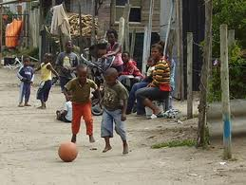
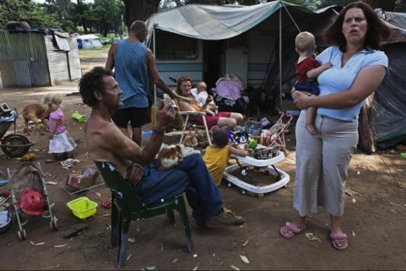
4.2 Inequality and poverty in South Africa
Section 4.2 of the study guide

Slide 12
4.3 Poverty, inequality and social welfare
Todaro & Smith (2009: 222-224, 227-233)
Why is inequality above poverty line a concern?
  Leads to economic inefficiency
    Less people qualify for credit
    Less savings as it is the middle class tat saves
    Overemphasis on tertiary education to the expense of primary education
  Undermines social stability and solidarity
    Rich have more political power – will resist change
    Facilitates rent-seeking
    The poor people support populist policies that is self-defeating – redistribution rather than increasing
  Unfair
    Need some inequality as incentive for hard work and innovation
    Need less inequality than in world at present

Slide 13
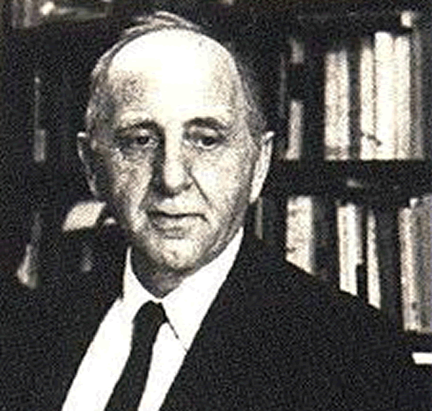
Kuznets inverted U-hypothesis
  Counter-argument against policy of redistribution
  Early stage of economic growth – more inequality
  Will improve at later stage
  Fig 5.10
  Explanation for phenomenon
    Structural change, as in Lewis model
  Effect not inevitable – depends on character of growth

Slide 14
4.4 Absolute poverty: Extent and magnitude
Todaro & Smith (2009: 233-238)
Difficult to estimate, varies around the developing world
Depends on two factors:
  Average level of national income
  Degree of inequality in its distribution
Less than PPP $1:
  9.1% of East Asia & Pacific
  8.6% of Latin America & Caribbean
  1.5% of Middle East & North Africa
  31.7% of South Asia
  41.1% of Sub-Sahara Africa

Slide 15
Growth and poverty
  Is there conflict between the two goals of reducing poverty and accelerating growth
  Five reasons why policies to reduce poverty will not necessarily lead to slower growth rates:
    Poor can not get credit, or save, or finance children’s education – have many children for old-age security
    Rich do not save and invest substantial proportions of their income
    Low income → poor health, nutrition, education → lower productivity
    Higher income will stimulate overall increase in demand for locally produced goods
    Reducing mass poverty → will stimulate econ expansion by providing an incentive for widespread participation in the development process
Overly aggressive & ill-designed policies to redistribute income and reduce poverty can however harm econ growth

Slide 16
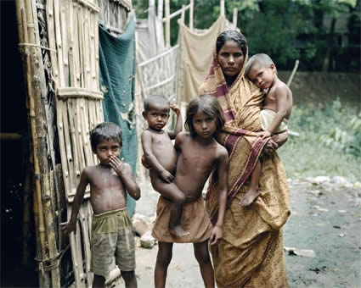
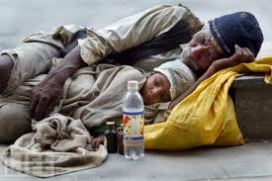
4.5 Characteristics of poverty groups
Rural poverty
Women in poverty
Ethnic minorities Todaro& Smith (2009:238 -244)
Poor comes from poor countries

Slide 17
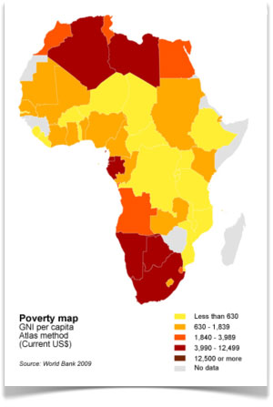
The range of policy options: some basic considerations
Changing the functional distribution of income by changing relative factor prices .
Changing size distribution through progressive redistribution of asset ownership.
Reduce size distribution at upper levels through progressive income and wealth taxes.
Direct transfer payments and public provision of goods and services.
May be useful to impose a work requirement before food aid is provided.

Slide 18
PREPARATION FOR THE EXAM
Section A: Compulsory question
Section B: 4 Questions – you have to do 3
(of 20 marks each)
Inequality, poverty will always be tested in the Exam

