Slide 1
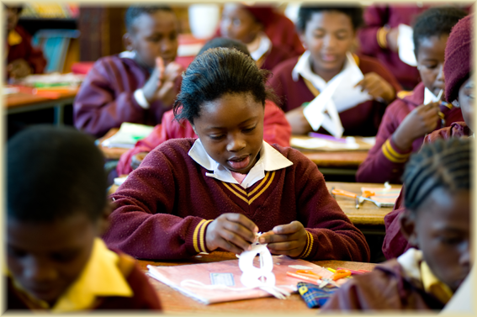

Study unit 6
Human capital: Education and health development

Slide 2
Study unit 6
Human capital: Education and health development
The central roles of education and health
Education and health as joint investments for development
Investing in education and health: Human capital
Child labour
The gender gap: women and education
Educational systems and development
Health systems and development
Policies for health, education and income generation

Slide 3
Central roles of education
Todaro & Smith (2009: 369-371)
Summary of content
Education and health are both basic objectives of development
  Health is central to well-being
  Education is essential for a satisfying and rewarding life
Education and health are also components of development
– inputs in production function
  Education key to ability to absorb modern technology and develop capacity for self-sustained growth and development
  Health is a prerequisite for increases in productivity
  Successful education relies on adequate health
Dual role of inputs and outputs give education and health a central role in economic development

Slide 4
6.2 Education and health as joint investment for development
Todaro & Smith (2009: 372-373)
Summary of content
Health & investment closely related in econ development – investment in the same individual
  Better health leads to higher returns on investment in education:
    Improves school attendance
    Children more successful in learning
    Lower mortality of school-age children
    Longer life-expectancy: can use education more productively later in life
  Better education leads to higher returns on investment in health:
    Many health programs rely on skills learned in school (for example literacy and numeracy)
    Schools teach basic hygiene and sanitation
Education needed to train health workers

Slide 5
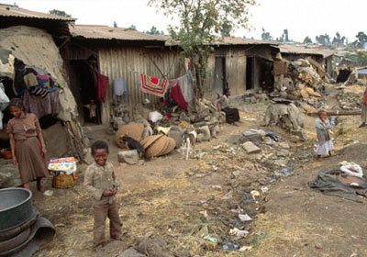
Health and education levels improved in all countries over past 50-60 years
  More improved in developing countries – international convergence
  Falling life expectancies in Sub-Sahara Africa – will not catch up in terms of health
  Primary enrolments increased in developing countries – doubts about the quality gap

Slide 6
6.3 Investing in education and health: human capital approach
Todaro & Smith (2009: 375-378)
Summary of content
Human capital approach - analysis of investment in health and education
Human capital: term used for education, health and other human capacities that can raise productivity when increased
Initial investment in education, health → stream of higher future income generated from expansion of education or improved health → can deduce rate of return by estimating the present discounted value of the increased income stream

Slide 7
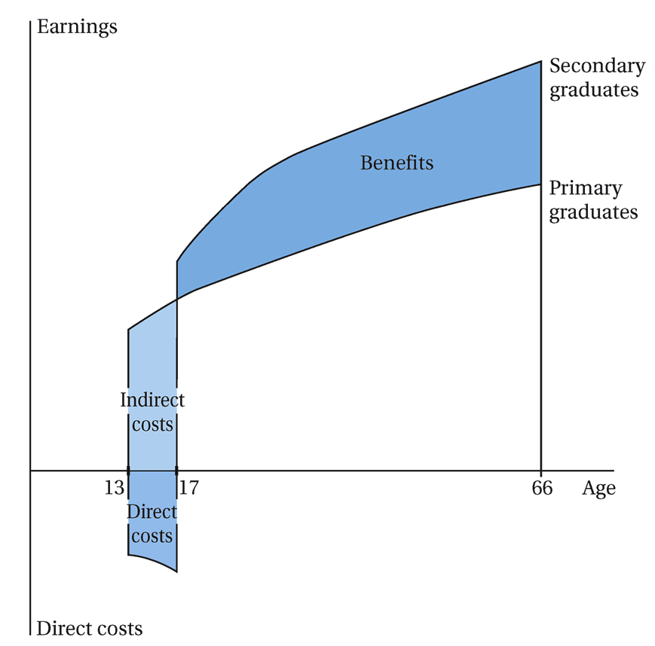
Figure 8.2: Financial trade offs in the decision to continue school

Slide 8
Figure 8.2 Financial trade offs in the decision to continue school
Fig 8.2: schematic representation of the trade-offs involved in the decision to continue in school
  Assume individual works from time he finishes with school until he is unable to work or dies – use current world life expectancy of 65 years.
  Diagram shows two earnings profiles: (1) for workers with primary school but no secondary education, and (2) those with a full secondary (but no higher) education.
  Workers (1) start working at age 13, workers (2) at 17.
  The decision to continue with secondary education means foregoing 4 years of income – indirect cost as shown in diagram.
  Direct costs refer to fees, school uniforms, books and other expenditure related to the secondary education.
  Over the rest of workers (2) lives, they make more money each year than would have been possible with only primary education – labeled ‘benefits’ in diagram
This analysis also applicable to investment in health

Slide 9
6.4 Child labour
Todaro & Smith (2009: 378-382)
Summary of content
Widespread problem in developing countries
  Disrupts schooling, physical stunting of working children, cruel and exploitative working conditions
  120 million children work full-time + 130 million work half-time
    61% in Asia
    32% in Africa
    7% in Latin America
  Child labour rate:
    Highest in Africa: 41% of children between 5 and 14
    Asia – 21%
    Latin America – 17%
  More than 20 000 children die annually due to work-related accidents
Immediate ban on all forms of child labour not always in best interests of children
  Without work – no money for school fees, basic nutrition and health care

Slide 10
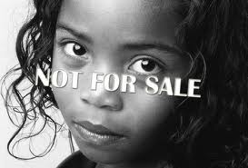
ALL WORK NO PLAY

Slide 11
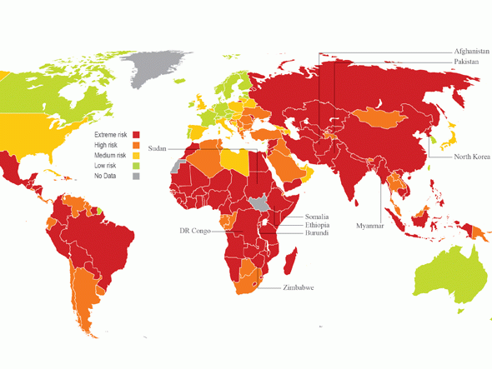

Slide 12
FOUR main approaches to child labour
Four main approaches to child labour policy:
  Child labour is an expression of poverty
    Eliminate poverty
    Associated with World Bank
  Find strategies to get more children into school
    Build more schools to ensure more places in school available
    Conditional cash transfer incentives, such as Progresa/Opportunidades program in Mexico
    Wide support from many international agencies and development bodies
    Probably more effective approach than merely making basic education compulsory
  Child labour is inevitable in short term
    Regulate child labour to make it less abusive
    Provide support services for working children
    Associated with UNICEF
  Ban child labour
    If total ban not possible, then ban it in its most abusive forms
    Associated with the ILO

Slide 13
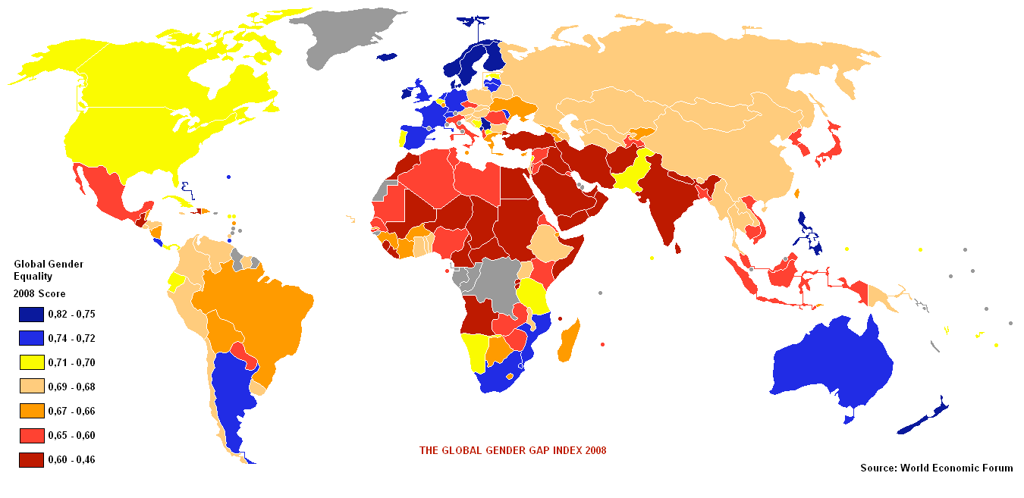
6.5 The gender gap: women and education

Slide 14
Todaro & Smith (2009: 382-386)
Summary of content
Educational gender gap: young females receive less education than young males in most low-income developing countries
Majority of illiterate people and those that do not attend school are female
Problem biggest in least developed countries in Africa, but also relatively large in South Asia
Why is female education important?
  Educational discrimination against females hinders economic development, and
  Reinforces social inequality

Slide 15
4 reasons why it is economically desirable:
  Rate of return on women’s education is higher than that for men
  Women’s productivity increases, and results in greater labour force participation, later marriage, lower fertility, improved child health and nutrition
  Multiplier effect of improved child health and educated mothers on the quality of future human resources
  Will break vicious cycle of poverty as women carry a disproportionate burden of poverty and landlessness

Slide 16
Consequences of gender bias in health and education:
  Education of girls – highest rates of return of any investment
    Discrimination against girls therefore costly in terms of achieving development goals
  Most cost-effective way to improve local health standards
  Shows link between economic incentives and cultural setting
    Boys preferred because they will provide future economic benefits
    Girls will involve future costs (eg dowry upon marriage)
    Possible explanation for “missing women” mystery
      Less females as share of population than predicted by demographic norms
      More than 100 million missing
      Continue to worsen in China and India
  Greater mother’s education improves prospects for health and education of both boys and girls
    Mother’s education plays decisive role in raising nutritional levels in rural areas – positive link between higher educated mother and less stunted children

Slide 17
6.6 Educational systems and development
Todaro & Smith (2009: 387-397)
Summary of content
Amount of schooling received by individual is largely determined by demand & supply
Self study – read and summaries

Slide 18
6.7 Health systems and development
Todaro & Smith (2009: 397-400, 413-415)
Summary of content
Measurement and distribution
  Life expectancy
    Improved in most regions
    Sub-Sahara – effect of AIDS
  Under-5 mortality
    Progress but rate of improvement slower since 1980
  DALY: disability-adjusted life year
    New measure by WHO – controversial, doubts about quality of data
    One-quarter of global disease burden: diarrhoea, childhood diseases like measles, respiratory infections, parasitic worm diseases, malaria – all major problems in developing countries
  Progress in all, but averages mask inequalities
Health Systems Policy
  Great variability in the performance of health systems at each income level
  Importance of formal public health system
    Public funding often used inefficiently

Slide 19
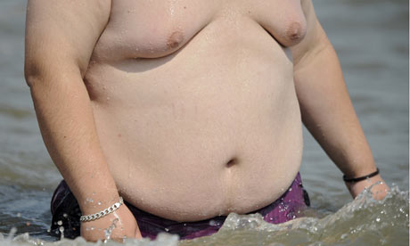
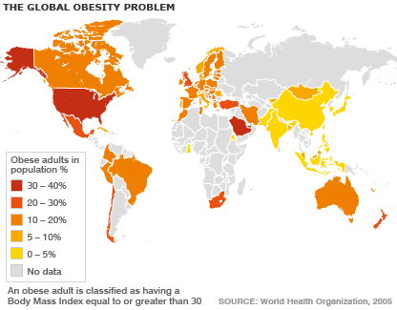
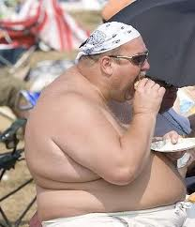
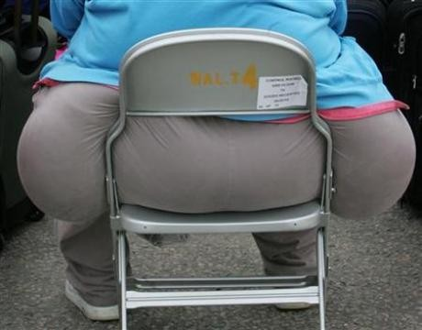
It is renowned for surfing, rugby and the great outdoors, but South Africa is among the fattest countries in the world, a survey has found.
The rainbow nation is "eating itself slowly to death", according to the drug and healthcare company GlaxoSmithKline (GSK), which says 61% of South Africans are overweight, obese or morbidly obese.
Despite the country's sporty reputation and the prevalence of gyms in cities such as Johannesburg, the research found that 49% of South Africans do not exercise and 71% have never dieted. Most worryingly, 17% of children under nine are overweight.

Slide 20
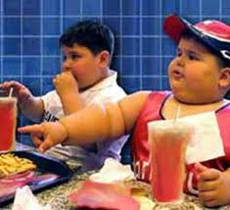
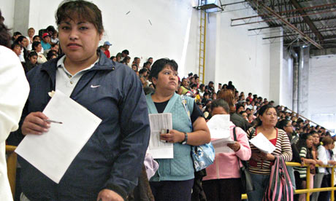
6.8 Policies for health, education and income generation
Todaro & Smith (2009: 416-419)
Summary of content
PROGRESA (Mexico)
Integrated package to promote the education, health and nutrition status of poor families.
Provides cash transfers to poor families, family clinic visits and other in-kind nutritional supplements
Other health benefits for pregnant and lactating women and their children under 5.
Some of these benefits are conditional to children attending school regularly

Slide 21
PREPARATION FOR THE EXAM
Section A: Compulsory question
Section B: 4 Questions – you have to do 3
(of 20 marks each)
Human capital and health will always be tested in the Exam

