Slide 1
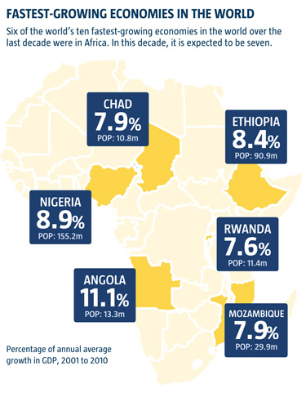
Study Unit 2: The economics of growth
In the past decade, Africa has been home to six of the 10 fastest-growing economies in the world – a number that is only projected to grow
Although economic growth does not guarantee increased human well-being, in the longer run it is almost impossible to increase living standards in a sustainable manner without economic growth. Nobel Prize winner Robert Lucas once said that it is hard to think about anything else once one begins to think about the question why some countries grow so much faster than others.
www.coons.senate.gov/embracing-africas-economic-potential

Slide 2
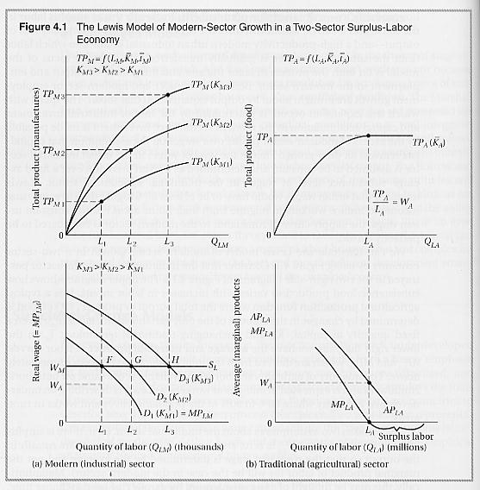
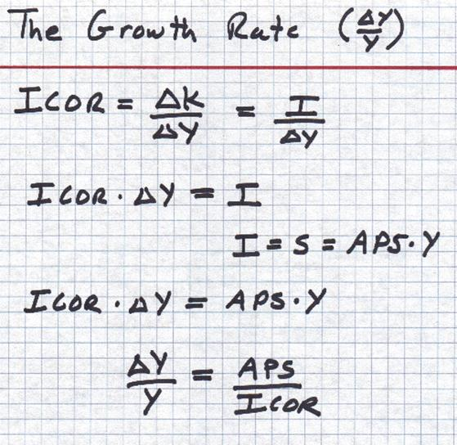
Theories of Economic development
Classic theories of economic development
Linear stages theories – development as growth
Structural change models
The international dependence revolution
The neoclassical counterrevolution
The Solow neoclassical growth model
Components of economic growth
New growth theory: endogenous growth
Source: Todaro and Smith 2011
Source: www.instruct.uwo.ca

Slide 3
Harrod - Domar growth model
Economy must save proportion of national output to replace worn-out capital goods
To grow → new investments to increase net capital stock
Assume:
direct economic T relationship between size of capital stock (K) and GDP (Y)
Any net addition to capital stock will lead to an increase in GDP
Relationship between K and Y → capital–output ratio (k)
net savings ratio (s) is fixed proportion of national output
total new investment is determined by level of total savings
GDP growth (ΔY/Y) = s/k
Determined by:
national savings rate (s)
national capital/output ratio (k)
Economies must save and invest a proportion of their GDP for economic growth to happen

Slide 4
Example:
According to the Harrod-Domar growth equation how quickly would the South African economy have grown in 2012 if the gross savings ration increase by 8% and the average capital-output ration to 4,5%?
          GDP growth (ΔY/Y) = s/k
          = 8% (s) ÷ 4,5% (k)
          = 1,78%

Slide 5

Structural change models: Lewis theory of Development
Source: Todaro and Smith 2011

Slide 6
Lewis theory of development
Lewis proposed his dual sector development model in 1954. It was based on the assumption that many LDCs had dual economies with both a traditional agricultural sector and a modern industrial sector. The traditional agricultural sector was assumed to be of a subsistence nature characterised by low productivity, low incomes, low savings and considerable underemployment. The industrial sector was assumed to be technologically advanced with high levels of investment operating in an urban environment.
Lewis suggested that the modern industrial sector would attract workers from the rural areas. Industrial firms, whether private or publicly owned could offer wages that would guarantee a higher quality of life than remaining in the rural areas could provide. Furthermore, as the level of labour productivity was so low in traditional agricultural areas people leaving the rural areas would have virtually no impact on output. Indeed, the amount of food available to the remaining villagers would increase as the same amount of food could be shared amongst fewer people. This might generate a surplus which could them be sold generating income.
Those people that moved away from the villages to the towns would earn increased incomes and this crucially according to Lewis generates more savings. The lack of development was due to a lack of savings and investment. The key to development was to increase savings and investment. Lewis saw the existence of the modern industrial sector as essential if this was to happen. Urban migration from the poor rural areas to the relatively richer industrial urban areas gave workers the opportunities to earn higher incomes and crucially save more providing funds for entrepreneurs to investment.
A growing industrial sector requiring labour provided the incomes that could be spent and saved. This would in itself generate demand and also provide funds for investment. Income generated by the industrial sector was trickling down throughout the economy.

Slide 7
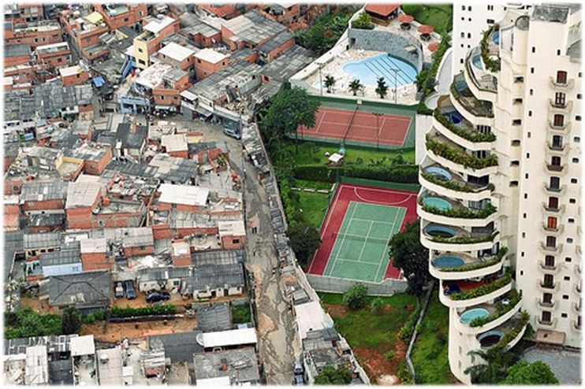
The international dependence revolution
Neo-colonial dependence model
False-paradigm model
The dualistic – development thesis
What are the major policy implications of these models?
What are the major strengths a weaknesses of these models?
Source: www. womennewsnetwork.net/2012/03/14/careers-improve-life-women-brazils-slums/

Slide 8
Neoclassical counterrevolution
Free – market analysis
Public choice theory
Market – friendly approach
What are the major policy implications of these models?
What are the major strengths a weaknesses of these models?
Traditional neoclassical growth theory - exogenous
The Solow neoclassical growth model
Production function
Returns to scale
Steady state

Slide 9





The Solow Neoclassical growth model
Todaro and Smith: 2011, Appendix 3.2

Slide 10
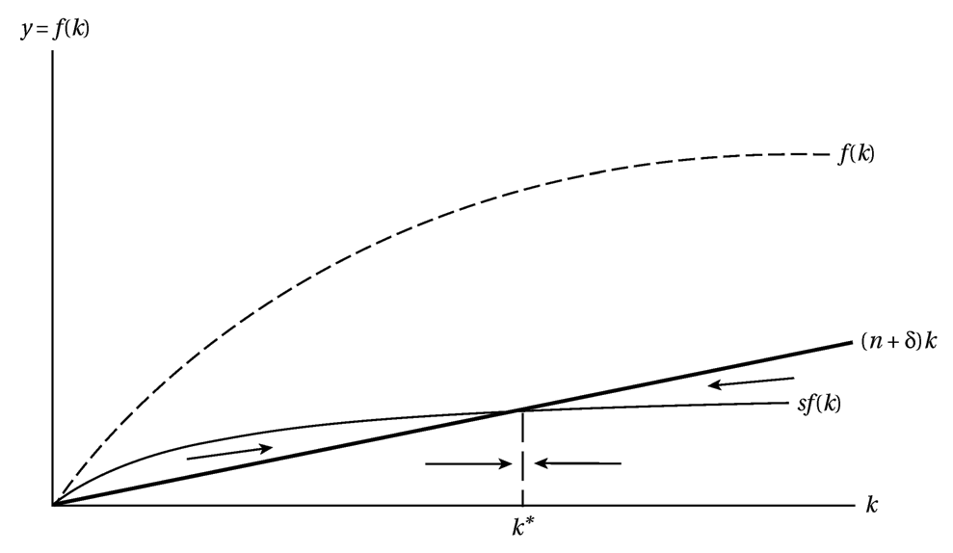
Equilibrium in die Solow Growth Model
Todaro and Smith: 2011, Appendix 3.2

Slide 11
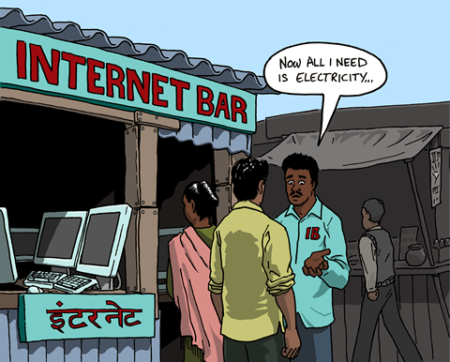
Components of economic growth
Capital accumulation
Growth in the population
Technological progress
Source: www. www.global-inst.com/ideas-for-tomorrow/2012/the-myth-of-technological-progress.html

Slide 12
Endogenous growth theory: new growth theory
Capital accumulation
Population growth
Technological progress
Gap between the availability of technology and basic necessities
The gap between the availability of technological devices (mobile phones, computers) and basic necessities (safe water, electricity, affordable housing) in the developing world should send a clear signal that technological progress does not necessarily contribute to meeting development needs and fostering human progress. The irony is that these technologies have penetrated impoverished villages in India, Indonesia and the Philippines whilst adequate sanitation and water supply essential to improving the basic quality of life still remain elusive.
Today, more than 2.2 billion Asians have cell-phones, which is far more than the number of people who have access to potable water or sanitary toilets. According to the Asian Development Bank (ADB), some two billion Asians (66 per cent of the region’s population) lack access to adequate sanitation. In most Asian cities, less than 30 per cent of the residents enjoy 24-hour supplies of water. Low service coverage and intermittent water supplies are the norm. Across South Asia, where 400 million people are poor, Internet-capable phones are rivalling laptops, desktop computers and tablets as primary Internet access points in households, as a November 2011 report from Nielsen highlights. This data sharply contrasts with the fact that 25 per cent of children in this region are born underweight at 2.5 kilograms or less.

Slide 13
Examination preparation:
Essay questions
Diagrams and equations
Definitions
Describe …..
Explain …….
Work through all the question in the Study guide

