Slide 1
Curriculum
Models

Slide 2
A Definition of Curriculum
(Daniel Tanner, 1980)
“The planned and guided learning experiences and intended learning outcomes, formulated through the systematic reconstruction of knowledge and experiences, under the auspices of the school, for the learners’ continuous and willful growth in personal social competence.”

Slide 3
SUBJECT-CENTERED
Design Model

Slide 4
Subject-Centered Curriculum
This model focuses on the content of the curriculum.
The subject centered design corresponds mostly to the textbook written for the specific subject.

Slide 5
Subject-Centered Curriculum
The subject-centered curriculum can be focused on
  traditional areas in the traditional disciplines
  interdisciplinary topics that touch on a wide variety of fields
  on processes such as problem solving
  on the goal of teaching students to be critical consumers of information.

Slide 6
Subject-Centered Curriculum
A curriculum can also be organized around a subject center by focusing on certain processes, strategies, or life-skills, such as problem solving, decision making, or teamwork.

Slide 7
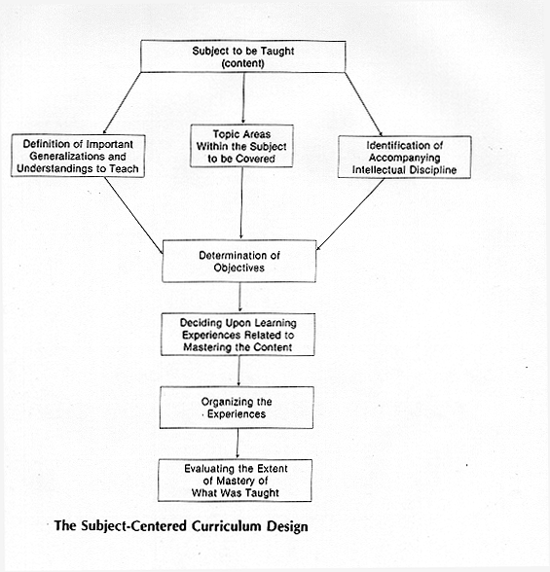

Slide 8
Subject-Centered Curriculum
In the Philippines, our curricula in any level is also divided in different subjects or courses. Most of the schools using this kind of structure aim for excellence in the subject matter content.

Slide 9
Examples of Subject-centered curriculum:
1. Subject Design
The drawback of his design is that sometimes learning is so compartmentalized.
It stresses so much the content that it forgets about students’ natural tendencies, interest and experiences.
2. Discipline Design
Discipline refers to specific knowledge and through a method which the scholars use to study a specific content of their fields.

Slide 10
Examples of subject-centered curriculum:
3. Correlation Design
This comes from a core, correlated curriculum design that links separate subject designs in order to reduce fragmentation. Subjects are related to one another but each subject a maintains its identify.
4. Broad field design/interdisciplinary
This design was made to prevent the compartmentalization of subjects and integrate the contents that are related to each other.

Slide 11
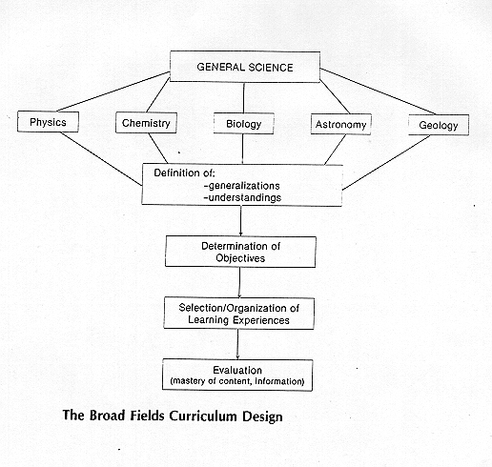

Slide 12
Examples of Subject-centered curriculum:
Students in history should learn the subject matter like historians, students in biology should learn how biologist learn, and so with students in mathematics should learn how mathematicians learn.
The discipline design model of curriculum is often
used in college
Discipline becomes the degree program.

Slide 13
Reflection:
Let’s review the following:
    Basic Education Curriculum (BEC)
    Secondary Education Development Program (SEDP)
    College Algebra syllabus
What curriculum design(s) do you find?
Do your schools support the subject – centered curriculum?

Slide 14
Learner-Centered Curriculum
centered on certain aspects of the learners themselves.
may explore the learner’s own life or family history or local environment.

Slide 15
Learner-Centered Curriculum
Child-centered design
(John Dewey, Rouseau, Pestallozi and Froebel )
It is anchored on the needs and interests of the child.
The learner is not considered as a passive individual but as one who engages with his/her environment. One learns by doing. Learners interact with the teachers and the environment.

Slide 16
Learner-Centered Curriculum
2. Experience-Centered design
Experiences of the learners become the starting point of the curriculum.
Thus the school environment is left open and free.
Learners are made to choose from various activities that the teacher provides.
The learners are empowered to shape their own learning from the different opportunities given by the teacher.

Slide 17
Learner-Centered Curriculum
Humanistic design -
Abraham Maslow and Carl Rogers.Maslow
The development of self is the ultimate objective of leaning. It stresses the whole person and the integration of thinking, feeling and doing. It considers the cognitive, affective and psychomotor domains to be interconnected and must be addressed in the curriculum. It stresses the development of positive self-concept and interpersonal skills.

Slide 18
Advantages:
It gives power to the learners: they are identified as the experts in knowing what they need to know.
The constructivist element of this approach honors the social and cultural context of the learner.

Slide 19
Advantages:
It creates a direct link between in-class work and learners' need for literacy outside the classroom.
As a result, learners can more easily transfer new skills to day-to-day use (Purcell-Gates, et al., 2001). The immediacy of this transfer of skills at home, at work, and in communities also encourages learner persistence.

Slide 20
Disadvantages:
It often relies on the teacher's ability to create or select materials appropriate to learners' expressed needs.
This requires skill on the part of the teacher, as well as time and resources: at a minimum, texts brought in from real life, a wide pool of commercially available materials from which to draw, and a reliable photocopier. Given the reality of teachers' professional preparation and working conditions (Smith, et al., 2001), lack of skill, time and resources makes creating curriculum with this approach difficult.

Slide 21
Disadvantages:
Teachers may also find it difficult to strike an acceptable balance among the competing needs and interests of students.

Slide 22
Alternative Methods for a
Learner-Centered Curriculum
(These are only suggestions for supplementing your style, not substituting for it)
Individualized diagnosis and (some) course objectives Learning contracts
Programmed learning sequences Organize structured drills
Multi-sensory instructional activities Paired activities
Student-designed creative activities Design task cards
Small-group activities (in and out of class) Role play
Design competitive games Read aloud
Design problem solving games Sit on the floor in a circle
Focus on team learning/peer teaching Standard lecture
Change the seating configurations Teacher demonstrations

Slide 23
Alternative Methods for a
Learner-Centered Curriculum
(These are only suggestions for supplementing your style, not substituting for it)
Go outside or meet in an alternate location
Speedwriting
Listserve, online forums
Computer applications
Socratic dialogue (question-answer-deeper question)
Chunk knowledge and connect chunks to make “big picture”
Multimedia presentations (film, CDs, audio-tapes, animated graphics)
Student presentations (encourage multi-sensory supports)
Cancel class and meet students individually
Present multiple invention and discovery techniques (brainstorming, clustering, freewriting, idea letters, graph and object relationships, meditations, dreams, art, etc.)
Split Page (key phrases on one side, commentary on other)
Color code ideas in documents and lesson plans (already known, yet-to-learn, still negotiating)
Reverse question (look at answers and solutions first; create a question that it answers next)
Treat objective questions an essay questions

Slide 24
Reflection:
Let’s review the following:
    Basic Education Curriculum (BEC)
    Secondary Education Development Program (SEDP)
    College Algebra syllabus
What curriculum design(s) do you find?
Do your schools support the learner – centered curriculum?

Slide 25
Problem-Centered Curriculum
Problem-centered curriculum, or problem based learning, organizes subject matter around a problem, real or hypothetical, that needs to be solved.

Slide 26
Problem-Centered Curriculum
Problem-centered curriculum is inherently engaging and authentic, because the students have a real purpose to their inquiry -- solving the problem.

Slide 27
Problem-Centered Curriculum
Types of problems to be explored may include:
  Life situations involving real problems of practice
  Problems that revolve around life at a given school
  Problems selected from local issues
  Philosophical or moral problems

Slide 28
Problem-Centered Curriculum
1. Life-situations design
It uses the past and present experiences of learners as a means to analyze the basic areas of living.
As a starting point, the pressing immediate problems of the society and the student’s existing concerns are utilized.
Based on Herbert Spencer’s curriculum writing, his emphases were activities that sustain life, enhance life, and in rearing children, maintain the individual’s social and political relations and enhance leisure, tasks and feelings.
The connection of subject matter to real situations increases the relevance of the curriculum.

Slide 29
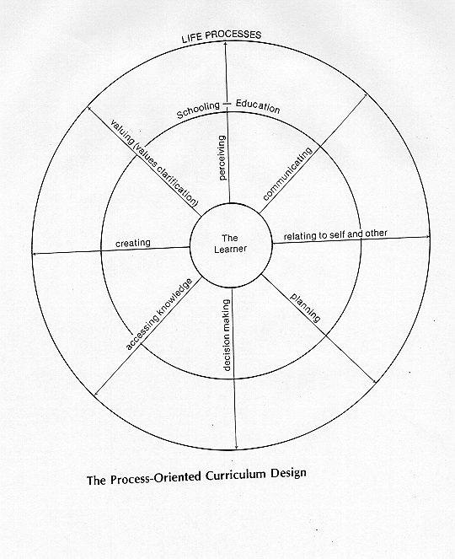

Slide 30
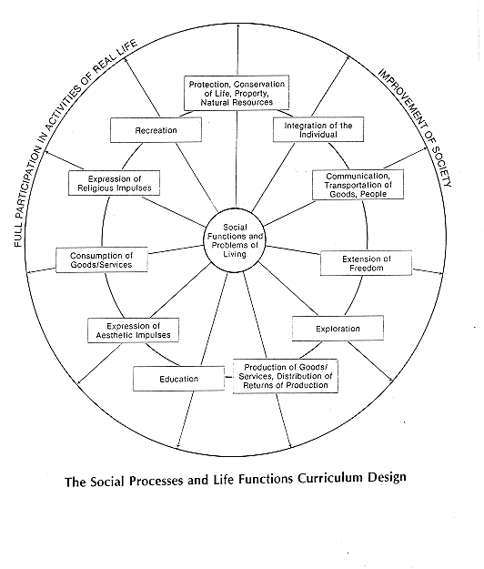

Slide 31
Problem-Centered Curriculum
2. Core design
It centers on general education and the problems are based on common human activities.
The central focus of the core design includes common needs, problems, concerns, of the learners.

Slide 32
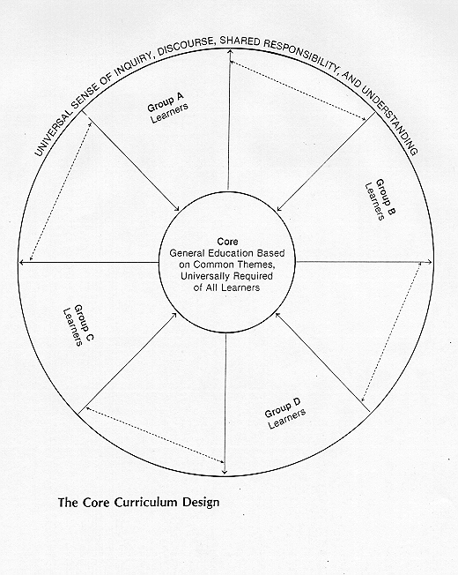

Slide 33
Reflection:
Let’s review the following:
    Basic Education Curriculum (BEC)
    Secondary Education Development Program (SEDP)
    College Algebra syllabus
What curriculum design(s) do you find?
Do your schools support the problem – centered curriculum?

Slide 34
Curriculum Development Models
These are based on a body of theory about teaching and learning.
These are targeted to needs & characteristics of a particular group of learners.
Outline approaches, methods, & procedures for implementation.

Slide 35
Curriculum Development Models
Deductive Models:
Saylor, Alexander, and Lewis’s
Tyler’s
Inductive Model:
3. Taba’s model

Slide 36
Models of Curriculum Development
The Taba Model
Taba took what is known as a grass-roots approach to curriculum development. She believed that the curriculum should be designed by the teachers rather than handed down by higher authority. Further, she felt that teachers should begin the process by creating teaching-learning units for their students in their schools rather initially in creating a general curriculum design.

Slide 37
Models of Curriculum Development
The Taba Model
an inductive approach to curriculum development, starting with specifics and building up to a general design

Slide 38
The Taba Model
Five-Step Sequence.
Producing pilot units - linking theory and practice
a.) Diagnosis of Needs
b.) Formulation of Objectives
c.) Selection of Content
d.) Organization of Content
e.) Selection of Learning Experiences
f.) Organization of Learning Activities
g.) Determination of what to evaluate and of the ways and means of doing it
h.) Checking for Balance and Sequence

Slide 39
The Taba Model
Five-Step Sequence (cont.):
Testing Experimental Units
Revising and consolidating
Developing a Framework
Installing and disseminating new units.

Slide 40
Saylor, Alexander, and Lewis’s conception of the curriculum planning process:
GOALS & OBJECTIVES
CURRICULUM DESIGNING
Decisions as to
design(s) made by
the responsible
curriculum planning group(s) for a
particular
educational center.
Various prior
decisions by
political
and social agencies
may limit the
final design(s).
CURRICULUM
IMPLEMENTATION
(Instruction)Decisions
as to instructional modes made by responsible teacher(s).
The curriculum plan includes alternative
modes with suggestions as to resources,
media, and organization, thus encouraging
flexibility and more freedom
for the teacher(s)
and students.
CURRICULUM
EVALUATION
Decisions as to evaluative procedures for determining learner progress made by
the responsible
teacher(s).
Decisions as to evaluative
procedures for evaluating the curriculum.
Plans are made by the
responsible planning
group.
Evaluative data become bases
for decision making
in further planning.

Slide 41
Models of Curriculum Development
The Saylor, Alexander, and Lewis Model
Curriculum: “a plan for providing sets of learning opportunities for persons to be educated.”
Curriculum planners begin by specifying the major educational goals and specific objectives they wish to be accomplished.

Slide 42
Models of Curriculum Development
The Tyler Model
The best or one of the best known models for curriculum development with special attention to planning phases is Ralph W. Tyler’s in his classic little book, Basic Principles of Curriculum and Instruction.

Slide 43
The Tyler Model of Curriculum Design
The nature and structure of knowledge
The needs of the society
The needs of the learner

Slide 44
Tyler:
Fundamental Questions in Developing Curriculum
What educational purposes should the school seek to attain?
What educational experiences can be provided that are likely to attain these purposes?
How can these educational experiences be effectively organized?
How can we determine whether and to what extent these purposes are being attained?

Slide 45
Reflection:
On what bases would you choose a model for curriculum development?
Who should decide which model for curriculum development to follow?
Is the Tyler rationale a suitable basis for current curriculum development?

