Slide 1
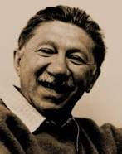
ABRAHAM MASLOW
1908 – 1970
Humanistic –Existential Paradigm
Self-actualization theory

Slide 2
Which of the following statements are true with reference to Maslow’s theory?
When all basic needs are met, people are self-actualised.
The tendency towards self-actualisation requires the regular gratification of lower level needs.
To be self-actualised is to accept the responsibility to be all you can be.
Once we are motivated by growth motives, deficiency motives fall away.
The correct answer is:
(a) and (b)
(b) and (c)
(c) and (d)
(a) and (d)
Answer: 2

Slide 3
Maslow’s perspective is characterised by:
Its emphasis on human potential
The conviction that people are essentially good and worthy
The emphasis on healthy and optimal functioning
The belief that human development can be explained in terms of need gratification
The correct answer is:
All of the above
(a) & (b)
(c) & (d)
(a),(b) & (c)
Answer: 1

Slide 4
According to Maslow’s theory, the concept of ___ explains how an individual is viewed as an integrated whole, as a person with worth and dignity and as one who strives towards the actualisation of his/her potential
Optimism
Humanism
Self-actualisation
Phenomenology
Answer: 2

Slide 5
According to Maslow self-actualisation:
Refers to a realistic evaluation of one’s potential
Is the motive to realise one’s true potential
Refers to healthy development
Dominates all other human needs
Answer: 2

Slide 6
According to Maslow, need gratification:
Is a process of fulfilling basic needs through strictly successive, developmental stages
Refers to self-actualisation
Is a means of relieving tension
Is the basis for growth and the realisation of an individual’s potential through self-actualisation
The correct answer is:
All of the above
(a) & (b)
(c) & (d)
(b),(c) & (d)
Answer: 3

Slide 7
Which of the following most accurately explain Maslow’s view of the person?
An individual has the potential to reach his/her highest level of functioning
An individual has an active will to develop, grow and reach his/her true potential.
Human behaviour can be explained in terms of need gratification since this largely forms the basis for growth and self-actualisation
Human behaviour is goal-directed and an individual is viewed as the central figure in the actualisation of his or her own potential.
The correct answer is:
All of the above
(b), (c) and (d)
(a), (b) and (c)
(c) and (d)
Answer: 1

Slide 8
According to Maslow’s conceptualisation of a hierarchy of needs:
Self-actualisation is a core need that dominates all other needs from birth onwards.
The lower the need in the hierarchy, the weaker it is.
Development progresses through successive stages of need gratification.
Growth motives refer to experiencing love and acceptance.
Answer: 3

Slide 9
According to Maslow, the satisfaction of self-esteem needs is mainly determined by…
(1) self-respect and appreciation by others.
(2) peak experiences.
(3) spontaneity, simplicity and naturalness.
(4) self-actualisation.
Answer: 1
Self-esteem is derived from a sense of efficacy or capability with regards to one’s own achievements as well as from recognition of one’s achievements by others. Alternative (1) is therefore correct.

Slide 10
Maslow’s self-actualisers…
(1) take delight in simple pleasures.
(2) are the most perfect individuals.
(3) conform to social norms.
(4) are dependent on others.
Answer: 1
(1): Self-actualisers are able to find pleasure in the small things in life. However, they are not perfect. Self-actualisation means that a person is able to discover and realise their fullest potential, but this does not make them perfect. Alternatives (3) and (4) are also incorrect: Self-actualisers do not conform to social norms but function relatively independently from their physical and social environment. They value autonomy and do not depend on external rewards such as popularity or prestige.

Slide 11
According to Maslow the self-actualisers is one who…
Is free from experiencing feelings of anxiety, guilt and conflict
Sees past the barriers that people erect, recognising reality for what it is
Laughs not only at the expense of others, but is also able to treat his/her own feelings of inferiority with lightness
Approaches life with the fresh naivety of a child.
The correct answer is:
(a), (b) & (d)
(a) & (b)
(c)
(b) & (d)
Answer: 1

Slide 12
According to Maslow, the satisfaction of self-esteem needs is mainly determined by…
(1) self-respect and appreciation by others.
(2) peak experiences.
(3) spontaneity, simplicity and naturalness.
(4) self-actualisation.
Answer: 1
Self-esteem is derived from a sense of efficacy or capability with regards to one’s own achievements as well as from recognition of one’s achievements by others. Alternative (1) is therefore correct.

Slide 13
Which one of the following statements correctly reflects Maslow’s view?
Self-actualisers are sociable people who like to have constant contact with other people.
Self-actualisers are achievers who will use any means to reach the high goals they have set themselves.
Self-actualisers function relatively independently of their physical and social environment.
Self-actualisers tend to be autocratic since they are functioning on a higher level than most people.
Answer: 3
Maslow stressed that self-actualising individuals are characterized by amongst others, the ability to observe reality more accurately. This means that, accurate observation assists them to make informed and accurate decision in reaching their goals, as opposed to using any means available to them as suggested by statement (2). Self-actualisers know when to disengage from social encounters and to enjoy isolation and privacy, as opposed to being in constant contact with other people as suggested by statement (1). Furthermore, self- actualisers are democratic in the widest sense of the word, which is in direct contrast with what statement (4) suggests. Yes, indeed, self-actualisers are described amongst others as individuals who function relatively independently of their physical and social environment and depend on their own potential to grow. Alternative (3) is therefore the correct option .

Slide 14
In terms of their interpersonal relationships, Maslow found that self-actualisers…
Are exclusive and disengaged from any real involvement with others
can be identified as cold and distant toward ordinary people
Acquire admirers, followers and disciples who demand more from self-actualisers that they can offer
Include in their close circle of friends each and every one irrespective of capacity, talent and level of growth
Answer: 3

Slide 15
On the basis of biographical information he assembled about people who are highly self-actualising, Maslow set out to describe the characteristics of the optimally functioning person. Which of the following statements are accurate descriptions of some of these characteristics?………………………………………
The behaviour of self-actualisers is spontaneous and without superficiality and pretence
Self-actualisers become irritated by the deficiencies of ordinary people
Without exception, self-actualisers are involved in a cause outside their own skins
Self-actualisers sometimes tire of the simple and basic enjoyments of life
The correct answer is:
(a), (b), (c) & (d)
(a), (b) & (c)
(a), (c) & (d)
(a) &(c)
Answer: 4

Slide 16
According to Maslow, the person who functions optimally
can meet his or her deficiency needs regularly.
has accepted the responsibility of self-actualisation.
is functioning at the level of self-actualisation.
The correct answer is:
(a)
(b)
(a) and (c)
(a), (b) and (c)
Answer: 4
The description of an optimally developed person is outlined fully on pg. 347- 352, MMV. With that in mind, it is pretty obvious that all the above listed statements are correct. Alternative (4) is therefore the correct option.

Slide 17
According to Maslow, the person who functions optimally is someone who
Subjects his or her own needs for self-actualisation to the injunction to conform to the demands and prevailing norms of society
Needs the rewards and recognition and acclaim of his or her social circle and of society at large in order to realise his or her potential
Functions relatively independently of his or her physical and social environment
Has accepted the responsibility of becoming the best that he or she can be
The correct answer is:
(a) and (b)
(a) and (d)
(a), (b) and (d)
(c) and (d)
Answer: 4

Slide 18
Read the following for the next 2 Q’s.
Samuel is a teenage boy and an only child. Although his family did not have much, there was always food on the table and a roof over his head. His mother and father were loving and supportive parents who took good care of him. Samuel enjoyed school and had many friends. He was earning good grades and was recognised as the top performer in his class.
Tragically, Samuel’s parents were killed in a car accident a few months ago. After the accident, Samuel was placed in foster care. A few months later, his grades started to drop and he started missing school regularly.
Samuel told the social worker assigned to his case that, although he had a place to stay and food to eat, his foster parents were both very busy and had little time for him. He also told the social worker that he had joined a gang who understood him and what he was going through.

Slide 19
According to Maslow’s theory, prior to the accident in which his parents were killed, Samuel was functioning at the level of ____________ needs.
physiological
self-esteem
affiliation and love
safety
The correct answer is:
(a) and (b)
(b) and (c)
(c) and (d)
(a) and (d)
Answer: 2

Slide 20
Maslow selected representatives of the best in human nature that he could find, in order to elucidate his concept of self-actualisation. He concluded that:
The need for self-actualisation only operates in the lives of a small group of highly select people
Self-actualisers have reached a level of human perfection
Because they are so way above the average, ordinary people will not approach self-actualisers for support and advice
Fallibility and human weakness remain part of human being, no matter what level for psychological growth is achieved
Answer: 4

Slide 21
Which of the following statements about the need for self-esteem in Maslow’s hierarchy is/are correct?
It matters less how one achieves the respect one needs than the fact that one receives it
In order to be solid one’s self-esteem should be based on one’s actual worth and not on the opinions of others
The need occurs after the need for safety and before the needs for love and affiliation in the hierarchy
When a person’s need for self-esteem is unfulfilled he/she may feel inferior, weak and helpless
The correct answer is:
(a) & (c)
(b) & (d)
(a) & (d)
(b), (c) and (d)
Answer: 2

Slide 22
According to Maslow, the person who functions optimally is someone who:
Has overcome the restrictions of the environment and is able to satisfy his or her needs on all four lower levels of the hierarchy on a regular basis.
Does not pay particular attention to the moral and ethical codes of society but abides by his or her own rules
Has accepted the responsibility of self-actualisation and has become the best person that he or she can be
Has self-knowledge and self-insight, and observes and recognises reality for what it is.
The correct answer is:
All of the above
(d)
(a), (c) and (d)
(a), (b) and (c)
Answer: 1

Slide 23
Which of the following statements most accurately describe Maslow’s view on psychopathology?
Psychopathology results from the failure of the environment to provide for an individual’s basic needs
Unfulfilled basic needs will reach pathological levels only in a person to whom these needs represent some form of deficiency in their lives
Over-gratification of needs can lead to pathology
Unfulfilled meta-needs could lead to pathological conditions called meta-pathologies.
The correct answer is:
All of the above
(a), (c) and (d)
(a) & (b)
(c) & (d)
Answer: 4

Slide 24
In order to prevent psychopathology in society, Maslow believed that…
Ample provision should be made for the gratification of the basic needs of people
The fulfilment of meta-needs of people should be deemed important
There should be respect for the dignity and rights of every person
The over-gratification of needs should be encouraged to ensure the optimal mental health of people
The correct answer is:
(a), (b) and (d)
(a), (b) and (d)
(a) & (b)
(b), (c) & (d)
Answer: 3

Slide 25
According to Maslow, self-actualisation is not always attained because
most people evade responsibilities and shy away from the challenge to realise their talents and work towards self-actualisation.
the social environment can place obstructions in the way of a person’s growth towards self-actualisation.
it is a developmental achievement which only exceptional people attain. The ordinary person does not feel the need to function on the higher levels of self-actualisation.
most people have poor self-knowledge and do not know what they are capable of and consequently fail to realise their potential.
The correct answer is:
All of the above
(a), (b) & (d)
(b), (c) & (d)
(c) & (d)
Answer: 2
Maslow emphasized that it is every individual’s ultimate goal to reach his or her true potential Furthermore, the tendency towards self-actualisation is the tendency that underlies all behavior. It is then not true to say that ordinary people do not have the need to function on the higher level of self-actualisation. Read pg. 346, MMV to get more clarity on why statements (a), (b) and (d) are correct.

Slide 26
Maslow believes that meta-needs:
must be fulfilled to ensure maximal growth.
unlike basic needs, are not innate.
if unfulfilled, can also lead to pathological conditions.
refer to self-actualisation.
The correct answer is:
All of the above
(a), (c) & (d)
(b), & (d)
(b) & (d)
Answer: 2
Maslow stated very clearly that meta-needs are innate, just like basic needs and they also need to be fulfilled to ensure maximal growth. Self-actualization encompasses the meta-needs and when these needs are not met or fulfilled, they may lead to pathological conditions. In line with this explanation, all the above listed statements are correct except for statement (b). Therefore, (2) is the correct alternative. .

Slide 27
Joining a gang who understood the challenges he faced since the death of his loving parents indicates that Samuel has regressed to the level of ____________ needs in the hierarchy.
physiological
self-esteem
affiliation and love
safety
Answer: 3
Samuel was placed in foster care where there was food on the table and a roof over his head. Thus, his physiological needs and safety needs were being met. Samuel maintains that his foster parents did not have time for him. His needs for affiliation and love were therefore not being met. He thus regressed from functioning at the level of self-esteem to a lower level because, after losing the support and love of his parents, he was motivated by the need for love and affiliation. By joining the gang, he was looking to satisfy his needs for love and affiliation.

Slide 28
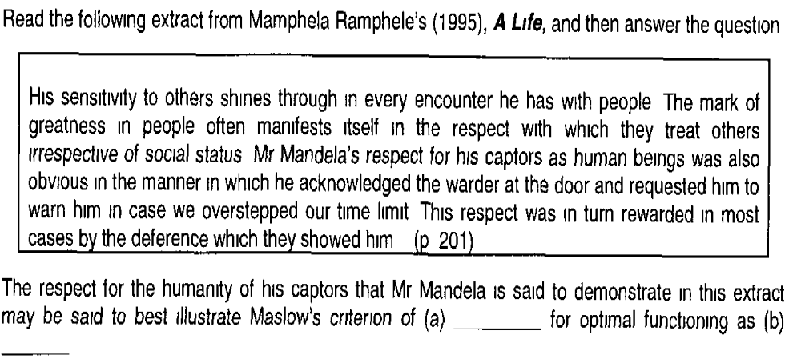

Slide 29
1 | spontaneity, simplicity and naturalness | he is able to see past the barriers his captors erect
2 | the consistent renewal of appreciation | his appreciation of their humanity shows that he does not tire of the simple, basic enjoyments of life
3 | discriminating between means and goals | he has a strong moral code and knows the difference between right and wrong, good and evil
4 | social feelings | he is able to demonstrate a concern for humankind in general
Answer: 4

Slide 30
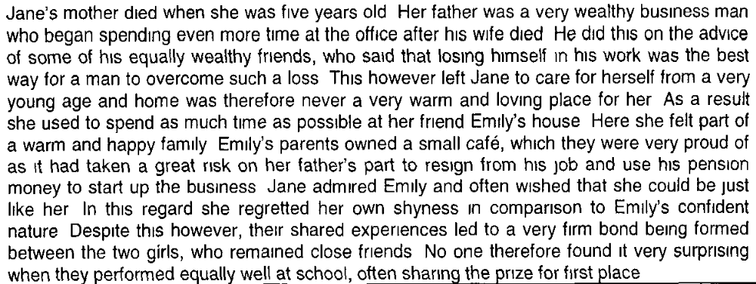

Slide 31
According to Maslow’s views on self-actualisation, which one of the following statements would most accurately describe Jane’s and Emily’s equal success at school?
Emily is functioning below her potential, as her favourable home circumstances should lead her to achieve more than Jane
While successful, Jane is still not realising her true talents, as her lower order needs are not being regularly satisfied
Jane’s ability to perform as well as Emily, despite her difficult home circumstances, indicates that she is functioning at the level of self-actualisation
None of the above
Answer: 4

Slide 32
According to Maslow’s views on self-actualisation, which one of the following statements about Jane’s and Emily’s fathers would you consider the most accurate?
Jane’s fathers’ willingness to take the advise of his friends rather than follow his own course is a sign of the trusting nature of the self-actualiser
Emily’s father’s courage to take a risk and start a new business is regarded as necessary for self-actualisation to occur
Janes’ father’s following of the cultural stereotype that men can only grieve by losing themselves in their work is an example of the lack of integration that prevents self-actualisation
Emily’s father’s decision to use all his pension money to start the new business seriously threatened his esteem needs, thereby blocking the path to self-actualisation.
The correct answer is:
(b) & (c)
(a) & (b)
(c) & (d)
(a) & (d)
Answer: 1

Slide 33
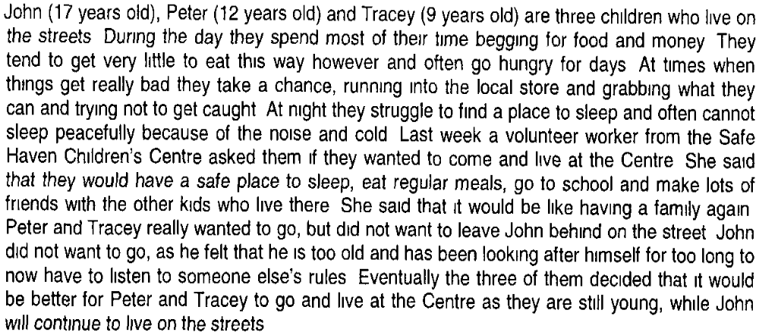
Read the following story

Slide 34
According to Maslow’s hierarchy of needs, which level are the children functioning on while living on the streets and why?
The affiliation and love needs level, as their physiological and safety needs are so frustrated that they turn to each other for support
The safety needs level, as they have to risk being caught and possibly locked up on a regular basis
The physiological needs level, as they spend most of their time looking for something to eat and a place to sleep
The self-actualization need level, as their hardship makes them determined to succeed
Answer: 3

Slide 35
According to Maslow the children’s effort to find food to eat and a place to sleep is a…..
Deficiency motive, as it will result in an increase of tension
Growth motive, as the aim is to evade an unpleasant circumstance
Deficiency motive, as it relates to their basic survival needs
Growth motive, as it demands satisfaction on a regular basis
Answer: 3

Slide 36
According to Maslow’s hierarchy of needs, when Peter and Tracey move into the Centre and John remains on the street, it can be expected that:
Peter and Tracey will begin to function on a higher level than John, as they are having more of their needs met regularly
John will continue to function on a higher level that Peter and Tracey, as he is older
Tracey will being to function on higher level that John and Peter, as girls generally develop faster than boys in the right environment
All of them will continue to function on the same level for at least the 1st year.
Answer: 1

Slide 37
According to Maslow’s hierarchy of needs, we can expect that when Peter and Tracey move into the Centre they will:
No longer experience their lower order needs as their affiliation and love needs will be met
Struggle for longer than other children their age to move beyond their physiological need level, as they have been deprived for so long
Still need to have their lower order needs regularly satisfied, even though they may begin to experience needs higher up in the hierarchy
Now will be able to move up the hierarchy in accordance with their specified developmental stage, as their environment is more nurturing.
Answer: 3

Slide 38
Maslow believes that meta-needs:
must be fulfilled to ensure maximal growth.
are known as growth motivations
emerge at the self-actualisation level.
are innate
The correct answer is:
All of the above
(b), (c) & (d)
(b), & (d)
(a) & (c)
Answer: 1

Slide 39
Which one of the following statements relating to Maslow’s conceptualisation of self- actualisation, is INCORRECT?
The fulfilment of basic needs will lead to the next step, namely, the achievement of self- actualisation.
Self-actualisation is a growth need which leads to fully-functioning, goal oriented being.
Even though self-actualisation has been achieved, a severe set-back in life may cause regression to a lower level of need.
A person may have fulfilled every deficiency need, yet feel restless and unhappy.
Maslow acknowledges that fulfilment of basic needs is a step towards self-actualization, it does not automatically ensure fulfilment of meta-needs. Gratification of the basic needs does not automatically solve all life challenges. This means that gratification of needs is not a given that one will achieve self-actualization, a lot needs to be in place, for example there are additional life tasks that need to be taken care of. Compared to other statements, alternative (1) is partially correct. However, given the explanation provided above, it is ruled out in terms of Maslow’s idea of self-actualization. Since you were requested to identify the incorrect statement, alternative (1) is then the correct option.
Answer: 1

Slide 40


Answer: 3

Slide 41

Answer: 2

Slide 42

Answer: 3

Slide 43

Answer: 4

Slide 44

Answer: 2

Slide 45
Ben has been in the same job for the same company for most of his working life. He works late hours, saves every possible cent of his income, and keeps telling his wife that she should be grateful for the security he is providing for his family. She feels that his many savings accounts and insurance policies do not make up for the little time he spends with his family, his restlessness, impatience and constant complaints about the children’s untidiness and the lack of order in the home. According to Maslow’s theory, which of the following statements may be applicable to Ben’s life?
Ben has achieved the level of self-actualisation at the expense of the happiness of his family.
Ben has not successfully progressed to the level where he can express and receive love and bond in an intimate way.
As a child, Ben’s safety needs may have remained acutely unfulfilled, resulting in him directing all his energies towards achieving security and stability in life.
Ben has most probably never realised his true talents nor become the kind of person he could have been had he not been so excessively concerned with achieving security and stability in his life.
The correct answer is:
(a), (b) & (c)
(b), (c) & (d)
(a) & (b)
(a) & (c)
Answer: 2

Slide 46
Walter, a child of a poor family, loved to draw and used whatever he could find to make little works of art. When he was old enough to work, he did not try and get a well-paying job like his brothers did but decided to do what he felt he was destined to be, namely, an artist. Doing odd jobs, he spent most of his money to buy the paints and art materials he needed. Even though he often went hungry, he took great delight in doing what he loved doing, namely, to make works of art. According to Maslow’s theory, this scenario
is impossible since self-actualisation only becomes possible when deficiency needs have been met.
is very likely since self-actualisation is a stronger and more dominant need than the deficiency needs.
demonstrates the fact that higher needs may sometimes motivate behaviour even when lower needs have not been gratified.
is foreign to the humanistic school of thought.
Answer: 3

Slide 47
The petrol attendants working for the local petrol station have always felt safe and secure in their work. However, the station is now under new management. The new manager feels that the station has too many employees and is working at a loss. He has devised a plan to reduce the working days for all of the which results in salary reductions. Over and above that, a point system has been introduced, meaning that the lower performance points one scores, the higher the chance for one to be retrenched. This unstable situation has left them feeling very helpless and insecure, and they fear that they will lose their jobs.
On which level of Maslow's hierarchy of needs are the petrol attendants' needs presently dominant?
Physiological needs
Safety needs
The need to belong
The need for self-esteem
Answer: 2

Slide 48
In terms of Maslow’s theory, the workers’ efforts to maintain high performance points, as an attempt to ensure their jobs, best describe which one of the following categories of motives?
Self-realisation motives / motivation
Growth motives / motivation
Deficiency motives / motivation
Survival motives / motivation
Answer: 3

Slide 49
Nancy is a successful business woman. She is confident, at peace with herself, satisfied with her life and comfortable with whom she is. Which one of the following characteristics from Maslow’s criteria for optimal functioning fits with the above scenario?
Exclusiveness
Self-acceptance
The democratic character structure
Task involvement
Answer: 2

Slide 50
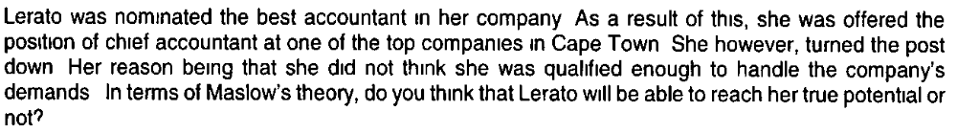
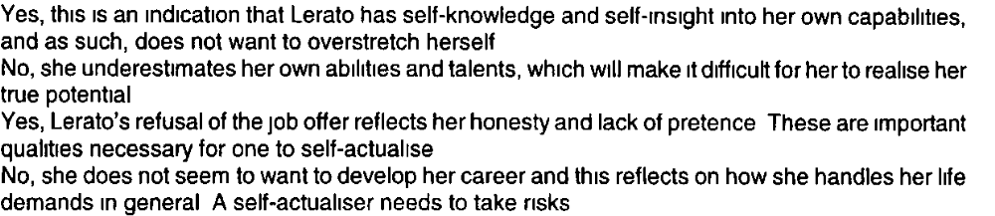
1
2
3
4
Answer: 2

Slide 51
Mosala is a qualified teacher, and began her teaching career with passion. However, her husband, who earned a good salary, insisted that she become a full-time homemaker before she even started her teaching career. Unfortunately, her husband died in a tragic accident last year. Her sister is now encouraging her to pursue her teaching career again because she believes that Mosala is cut out to be a teacher. Mosala is however hesitant because she does not trust her ability and she feels she might not do a good job. Meanwhile, she had developed new career ideas, but is uncertain about whether she will cope or not and hesitates to take the first step.
Where on Maslow’s hierarchy, do you think Mosala’s needs are most dominant at the end of the story?
Safety needs
Need for affiliation and love
Need for self-esteem
Need for self-actualisation
Answer: #3

Slide 52
According to Maslow’s view of the dynamics of personality, which one of the following statements applies to Mosala’s life so far?
Safety needs
Need for affiliation and love
Need for self-esteem
Need for self-actualisation
Answer: #3

Slide 53
According to Maslow’s view of the dynamics of personality, which one of the following statements applies to Mosala’s life so far?
Before her husband’s death, when Mosala was teaching, she was functioning on the level of self-actualisation
After Mosala's husband’s death it will unlikely be that she will be able to realise her potential
Mosala functions on the self-actualisation level, because she has developed new ideas
Mosala’s need for esteem ahs now diminished as a motivating force
Answer: 1

Slide 54
According to Maslow’s theory, for Mosala to ensure that her career ideas become a reality, she needs to:
Place a high priority on gratifying her basic needs
Listen to her sister’s advise and make the best of her teaching career and not make the mistake of confusing herself with too many ideas
Have the courage to take risks and overcome the limitations and barriers that she has created for herself
Develop self-knowledge and self-insight so as to actualise her potential.
The correct answer is:
(a)
(b)
(b), (c) & (d)
(a), (c) & (d)
Answer: #4

Slide 55
Some people find it difficult to actualise their potential. From the hypothesis given below, choose the statement/s that most accurately fit/s with Maslow’s theory:
The social environment creates obstructions and may even prevent people from reaching their full potential
People’s basic needs may not have been fully satisfied
People do not conform to the demands and prevailing norms of society
People underestimate their talents and fear success
The correct answer is:
All of the above
(d)
(a), (c) & (d)
(a) & (d)
Answer: #4

Slide 56
Which of the following statements most accurately represent Maslow’s view of the development of personality?
The meta needs are the needs that individuals should strive for to ensure ideal functioning
Someone who has reached the highest level of development functions at the level of self-actualisation and is motivated by growth and deficiency needs
Development proceeds in accordance with the need hierarchy
The higher in the hierarchy the level of motivation the higher the individuals’ level of development
The correct answer is:
All of the above
(c)
(a), (c) & (d)
(c) & (d)
Answer: #4

Slide 57
Tsholofelo is a 24 year old woman. Both her parents passed away in a tragic accident when she was only 6 years old. She was left with her grandmother who passed away when Tsholofelo was 11 years old. From then on, she was passed on from one family to the other, and as a result she neve had a stable sense of belonging with any of the families involved. At the age of 23 she married a very loving, caring and supportive man. Although she acknowledged that there is mutual love and caring between the two of them, she feels inadequate in her role as a wife and she feels that she is not good enough for her husband. :
According to Maslow’s hierarchy of needs, Tsholofelo’s feelings of inadequacy could be attributed to:
The frustration of her need for love and belonging as a child
Ungratified safety needs when growing up
Unfulfilled self-esteem needs when growing up
Ungratified physiological needs as a child
Answer: #3
The correct answer is:
a, b & c
c & d
a & b
All of the above.

Slide 58
Tsholofelo is a 24 year old woman. Both her parents passed away in a tragic accident when she was only 6 years old. She was left with her grandmother who passed away when Tsholofelo was 11 years old. From then on, she was passed on from one family to the other, and as a result she neve had a stable sense of belonging with any of the families involved. At the age of 23 she married a very loving, caring and supportive man. Although she acknowledged that there is mutual love and caring between the two of them, she feels inadequate in her role as a wife and she feels that she is not good enough for her husband. :
According to Maslow’s theory, Tsholofelo’s is presently functioning on the level of her __ needs
Self-esteem and affiliation and love
Self-esteem
Affiliation and love
Security
Answer: #3

Slide 59
In line with Maslow’s theory, which of the following would you regard as the optimal therapeutic consideration/s when dealing with Tsholofelo’s situation?
The therapist should create a therapeutic relationship within which the therapist shows respect for Tsholofelo’s innate character
The therapist’s main task is to create a trusting environment within which Tsholofelo will be able to discover and re-discover meaning in her life
The therapist should assume the role of a facilitator who will guide Tsholofelo towards gaining insight into her own deficient needs so that she can discover her true potential.
The correct answer is:
b & c
All of the above
a & c
c
Answer: #2

Slide 60
Vusi was really enjoying life. After making the many sacrifices needed to study hard and obtain his degree, he had just graduated from medical school. Before taking up a junior position in a very good practice he planned a two month trip overseas. A week before he was due to leave he was hijacked and beaten brutally one night on his way home. As a result of this Vusi decided to postpone his overseas trip. He became withdrawn and did not go out with his friends anymore as he was scared to drive around Johannesburg at night.
According to Maslow’s views on the functioning of the hierarchy, which one of the following statements would most accurately explain Vusi’s behaviour?
Before the hijacking Vusi was overly confident and had stopped paying attention to the dangers of living in Johannesburg. As a result of his experience he now functions at a higher level in the hierarchy as he has learnt to take care of his safety needs
Before the hijacking Vusi was following the career of his choice and was functioning on the self-actualisation level. The hijacking however threatened his safety needs and he has as a result returned to a lower level of functioning. He will now have to work his way back up the hierarchy
Before the hijacking Vusi was following the career of his choice and was therefore functioning on the self-actualisation level. The hijacking threatened his safety needs and he has temporarily returned to a lower level of functioning. When he gets over his shock he will return to his previous level of functioning.
Before the hijacking Vusi was only motivated by needs on the highest level of the hierarchy. As a result of the hijacking his behaviour is now affected by needs on more than one level of the hierarchy.
Answer: 3

Slide 61
Susan was a highly successful motivational speaker for large companies, a job she loved doing since she felt it allowed her to give full expression to her talents and expertise. It also gave her the opportunity to challenge others to make the best of their own lives and show her real concern and love for her fellow human beings. However, both her parents were tragically killed in a car accident. Susan lost all interest in her career. Like a child, she wanted to be held and comforted. She did not want to leave her familiar surroundings and clung to her memories of her parents, whom she loved dearly.

Slide 62
According to Maslow, thee needs Susan was meeting before her parents tragic death, are called (a)____, whereas the needs Susan experiencing after the death of her parents, are known as (b)______
1 | Meta 0r extrinsic needs Deficiency or basic needs, also known as intrinsic needs
2 | Lower or core needs, aka foundational needs Drive-motives, aka the stronger needs
3. | Congruency needs Survival needs
4 | Meta needs or B-values, aka growth motives Deficiency or basic needs
Answer: 4

Slide 63
Susan lapsed into safety and love needs after the shock of the death of her parents. This proves Maslow’s view that:
The lower the need in the hierarchy, the more urgent it is, which means that lower needs must first be gratified before needs at a higher level manifest themselves
Deficiency motives are directly related to the basic needs for survival, the gratification of which brings about a decrease in tension
When a person’s behaviour is directed by deficiency motives, his or her cognitive abilities are actually applied negatively because the objective is to avoid unpleasant situations
Once a person has reached a higher level of functioning, this does not mean that lower needs will never be experienced again.
The correct answer is:
(a) & (d)
(b) & (c)
All of the above
(d)
Answer: 3

Slide 64
According to Maslow’s theory, the full expression of Susan’s talents and expertise in her role as motivational speaker point to a functioning on the level of……
Self-esteem needs
Affiliation and love needs
Safety needs
Self-actualisation needs.
Answer: 4

Slide 65
According to Maslow……
Susan’s return to an earlier mode of functioning can be regarded as temporary, since she has already successfully functioned on a higher level
The loss of all interest in her career and her overwhelming needs at the present moment are indicative of the fact that Susan’s basic needs were never really met
Susan’s present quest for safety, and the warmth and positive regard of others, is hindering her actualisation tendency and is in conflict with her organismic potential
Susan’s regression to a lower level of functioning provides proof of fixation at this level during her childhood years.
Answer: 1

Slide 66
Tsholofelo is a 24 year old woman. Both her parents passed away in a tragic accident when she was only 6 years old. She was left with her grandmother who passed away when Tsholofelo was 11 years old. From then on, she was passed on from one family to the other, and as a result she neve had a stable sense of belonging with any of the families involved. At the age of 23 she married a very loving, caring and supportive man. Although she acknowledged that there is mutual love and caring between the two of them, she feels inadequate in her role as a wife and she feels that she is not good enough for her husband. :
According to Maslow’s hierarchy of needs, Tsholofelo’s feelings of inadequacy could be attributed to:
The frustration of her need for love and belonging as a child
Ungratified safety needs when growing up
Unfulfilled self-esteem needs when growing up
Ungratified physiological needs as a child
Answer: #3
The correct answer is:
a, b & c
c & d
a & b
All of the above.

Slide 67
Samson was the youngest of ten children. His family was very poor and could only afford to let their eldest son have an education. Samson was particularly envious of his brother and secretly felt that he was more intelligent than his brother, but was afraid that, if he did go to school this belief might prove false. Samson was also intimidated by an overly strict father who never allowed Samson to express any of his own ideas or venture and opinion on anything. Even though Samson’s mother believed and told him that he was a talented boy, Samson felt he was really a go0d-for-nothing and spent his time loitering in the streets, even indulging in petty theft.
According to Maslow Samson never attained self-actualisation because:
Restrictive and negative circumstances hampered Samson from actualising his potential
Samson, like Jonah, actually ran away from realising the talents that his mother and he himself at moments believed he had
He was afraid of overestimating himself
The correct answer is:
(a)
(a) & (b)
All of the above
(b) & (c)
Answer: 3

Slide 68
The fact that his father allowed him no say, whereas his mother told him he was talented, could have caused Samson to be hampered in his development by the following factor mentioned by Maslow as one of the causes of unfulfilled potential…..
The incapacitating conflict between the superego and the id
A lack of personality integration
Incongruent functioning
Contradictory environmental influences and condition
Answer: 2

Slide 69
Samson was afraid to really believe in himself- one of the reasons why he made no attempt to realise his potential. According to Maslow,
Samson lacked the so-called arrogance of creativity, the one thing necessary to realise ones’ potential
Samson needed pride as well as humility in order to realise his potential
Samson, instead of suffering from and inferiority complex, should have developed a superiority complex, enabling him to realise his potential
Samson was right in not thinking too much of himself, since he did not really have any potential to realise.
Answer: 2/1

Slide 70
According to Maslow’s theory, Samson’s envy of his educated brother and his secret belief that he was more intelligent that his brother can be seen as evidence of…
The will and need of every person to realise his or her potential
The will to meaning deeply embedded in every person
The aggressive side of human nature
The will to power underlying the striving to be superior
Answer: 1

Slide 71
Biography
Name: Abraham Harold Maslow
Birthdate: April 1, 1908
Birthplace: Brooklyn, New York
Parents: Samuel and Rose Maslow are Jewish emigrants from Russia.
He experienced anti-Semitism from his teachers and from other children around the neighbourhood. He had various encounters with anti-Semitic gangs who would chase and throw rocks at him.
Maslow had various problems within his own home. He and his father were constantly at odds. His father, Samuel, continually degraded him and pushed him to excel in areas that were of no interest to him. Samuel even publicly announced that his son was repulsively ugly.
Maslow’s mother treated him even worse than his father. Maslow deeply loathed his mother and wanted no interaction with her whatsoever. Maslow perceived his mother as being entirely insensitive and unloving. She exhibited no sign of affection or love for anyone she encountered, even her own family. Fortunately, a loving uncle, his mother’s brother, watched over him in adolescence and showed him what normality and decency were.

Slide 72
Maslow in a nutshell:
Maslow's hierarchy of needs is a motivational theory in psychology comprising a five tier model of human needs, often depicted as hierarchical levels within a pyramid.
Maslow stated that people are motivated to achieve certain needs and that some needs take precedence over others.
Our most basic need is for physical survival, and this will be the first thing that motivates our behaviour. Once that level is fulfilled the next level up is what motivates us, and so on.
This five stage model can be divided into deficiency needs and growth needs. The first four levels are often referred to as deficiency needs (D-needs), and the top level is known as growth or being needs (B-needs).

Slide 73
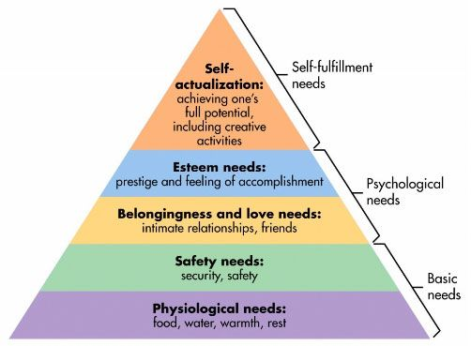

Slide 74
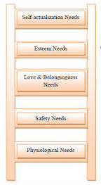
GROWTH Motives
DEFICIENCY Motives

Slide 75
Maslow in a nutshell:
The deficiency needs are said to motivate people when they are unmet. Also, the need to fulfil such needs will become stronger the longer the duration they are denied. For example, the longer a person goes without food, the more hungry they will become.
One must satisfy lower level deficit needs before progressing on to meet higher level growth needs. When a deficit need has been satisfied it will go away, and our activities become habitually directed towards meeting the next set of needs that we have yet to satisfy. These then become our salient needs.
However, growth needs continue to be felt and may even become stronger once they have been engaged. Once these growth needs have been reasonably satisfied, one may be able to reach the highest level called self-actualization.
Every person is capable and has the desire to move up the hierarchy toward a level of self-actualization. Unfortunately, progress is often disrupted by a failure to meet lower level needs. Life experiences, including divorce and loss of a job may cause an individual to fluctuate between levels of the hierarchy. Therefore, not everyone will move through the hierarchy in a uni-directional manner but may move back and forth between the different types of needs.
Maslow noted only one in a hundred people become fully self-actualized because our society rewards motivation primarily based on esteem, love and other social needs.

Slide 76
The original hierarchy of needs five-stage model includes:
Biological and Physiological needs - air, food, drink, shelter, warmth, sex, sleep.
Safety needs - protection from elements, security, order, law, stability, freedom from fear.
Love and belongingness needs - friendship, intimacy, trust and acceptance, receiving and giving affection and love. Affiliating, being part of a group (family, friends, work).
Esteem needs - achievement, mastery, independence, status, dominance, prestige, self-respect, respect from others.
Self-Actualization needs - realizing personal potential, self-fulfilment, seeking personal growth and peak experiences.

Slide 77
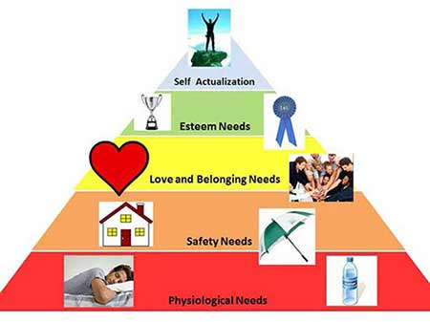

Slide 78
Self-actualization
Instead of focusing on psychopathology and what goes wrong with people, Maslow (1943) formulated a more positive account of human behaviour which focused on what goes right. He was interested in human potential, and how we fulfil that potential.
Psychologist Abraham Maslow (1943, 1954) stated that human motivation is based on people seeking fulfilment and change through personal growth. Self-actualized people are those who were fulfilled and doing all they were capable of.
The growth of self-actualization (Maslow, 1962) refers to the need for personal growth and discovery that is present throughout a person’s life. For Maslow, a person is always 'becoming' and never remains static in these terms. In self-actualization a person comes to find a meaning to life that is important to them.
As each individual is unique the motivation for self-actualization leads people in different directions (Kenrick et al., 2010). For some people self-actualization can be achieved through creating works of art or literature, for others through sport, in the classroom, or within a corporate setting

Slide 79
Maslow believed self-actualization could be measured through the concept of peak experiences. This occurs when a person experiences the world totally for what it is, and there are feelings of euphoria, joy and wonder.
It is important to note that self-actualization is a continual process of becoming rather than a perfect state one reaches of a 'happy ever after’
Maslow offers the following description of self-actualization:
'It refers to the person’s desire for self-fulfilment, namely, to the tendency for him to become actualized in what he is potentially.
The specific form that these needs will take will of course vary greatly from person to person.
In one individual it may take the form of the desire to be an ideal mother, in another it may be expressed athletically, and in still another it may be expressed in painting pictures or in inventions,

Slide 80
Characteristics of self-actualizers:
Concerned for the welfare of humanity;
Capable of deep appreciation of basic life-experience;
Establish deep satisfying interpersonal relationships with a few people;
Peak experiences;
Need for privacy;
Democratic attitudes;
Strong moral/ethical standards.
They perceive reality efficiently and can tolerate uncertainty;
Accept themselves and others for what they are;
Spontaneous in thought and action;
Problem-centred (not self-centred);
Unusual sense of humour;
Able to look at life objectively;
Highly creative;
Resistant to enculturation, but not purposely unconventional;

Slide 81
Characteristics of self-actualizers:
Concerned for the welfare of humanity;
Capable of deep appreciation of basic life-experience;
Establish deep satisfying interpersonal relationships with a few people;
Peak experiences;
Need for privacy;
Democratic attitudes;
Strong moral/ethical standards.
They perceive reality efficiently and can tolerate uncertainty;
Accept themselves and others for what they are;
Spontaneous in thought and action;
Problem-centred (not self-centred);
Unusual sense of humour;
Able to look at life objectively;
Highly creative;
Resistant to enculturation, but not purposely unconventional;

